Slide 1
Пакетно-оптические сети с поддержкой SDN/NVF
Anton Kostin, Sales Director Russia & Eastern Europe I BTI Systems

Slide 2
Definitions
SDN (Software Defined Networking): SDN is an architectural concept that encompasses the programmability of multiple network layers – including management, network services, control, forwarding and transport planes – to optimize the use of network resources, increase network agility, unleash service innovation, accelerate service time-to-market, extract business intelligence and ultimately enable dynamic, service-driven virtual networks.
• OpenFlow: In a classical router or switch, the fast packet forwarding (data path) and the high level routing decisions (control path) occur on the same device. An OpenFlow Switch separates these two functions. The data path portion still resides on the switch, while high-level routing decisions are moved to a separate controller, typically a standard server. The OpenFlow Switch and Controller communicate via the OpenFlow protocol, which defines messages, such as packet-received, send-packet-out, modify-forwarding-table, and get-stats.
• NFV (Network Function Virtualization): NFV aims to ... leverage standard IT virtualisation technology to consolidate many network equipment types onto industry standard high volume servers, switches and storage, which could be located in Datacentres, Network Nodes and in the end user premises... [NFV] is applicable to any data plane packet processing and control plane function in fixed and mobile network infrastructures.

Slide 3
Cloud is a Key Driver for SDN and NFV
Phase 1 - Data Centre Centric Cloud
Phase 2 - Carrier Cloud
Phase 3 - Fully Software Defined Cloud

Slide 4
Technology Themes
CAPEX
Convergence of layers
  Packet optical convergence
  Addition of application blades (L4 thru L7)
Virtualization
  Shared resources
Programmability
  Dynamic allocation of bandwidth (“bandwidth on demand”)
  Efficient “filling of the pipes” (wavelengths / services / applications
  Centralized management
OPEX

Slide 5
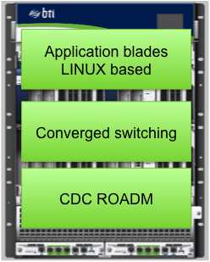
Converged Platform with Scale
Optical layer
  CDC ROADM
    programmable wavelength steering
    miximal wavelength fill of fiber
    Optical layer protection / resiliency
  100G / 400G programmable transponders
    Bandwidth on demand
    Increased ROI on fiber assets
Converged switching layer
  OTN and LSR on single platform
  Switch backplane for scale and efficient service fill on wavelength
  Service layer resiliency
Application blades
  Increased network performance
    Lower latency
    Adjacency
    Security etc
Converged platform offering
    VIRTUALIZATION
    SCALABILITY
    MONITIZATION

Slide 6
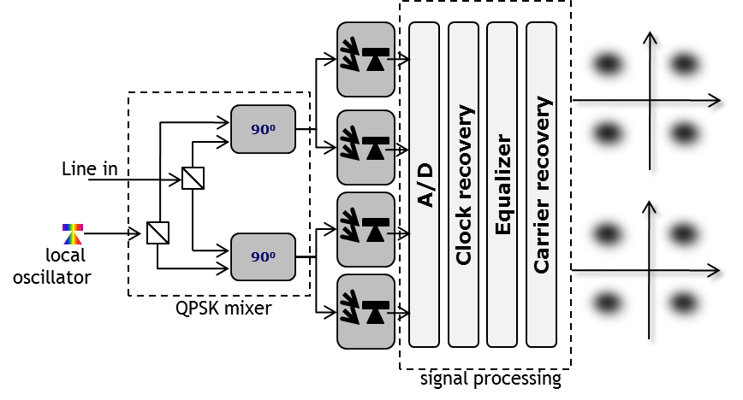
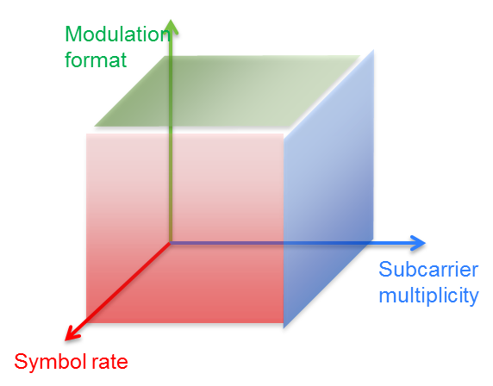
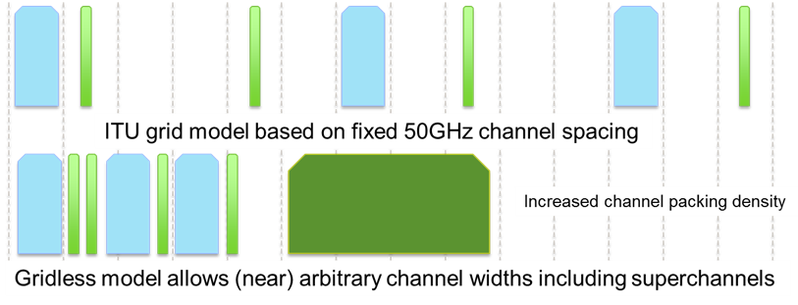
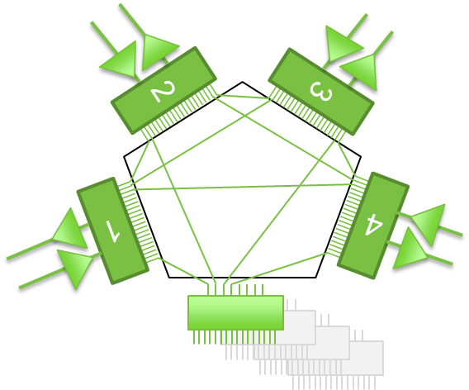
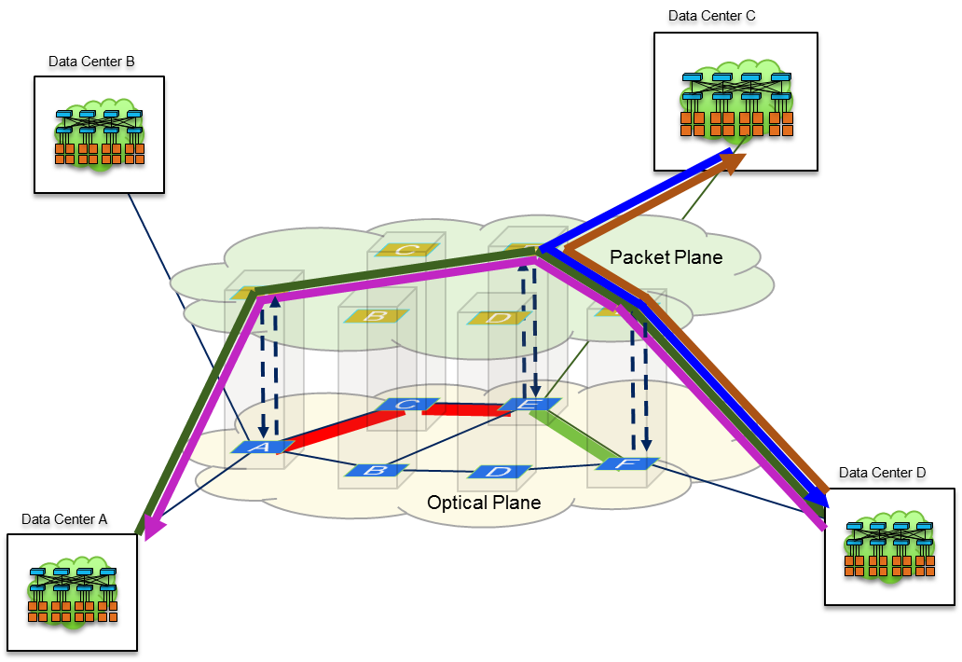
A Portfolio for Efficient Traffic Engineering
Coherent optics
  Programmable reach and latency
Modulation format
  Programmable capacity
Flexible grid
  Programmable spectrum allocation
CDC ROADM
  Programmable connectivity
Multi-layer optimization
  Programmable resources across layers

Slide 7
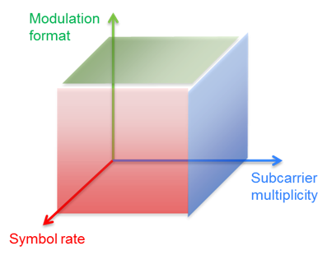
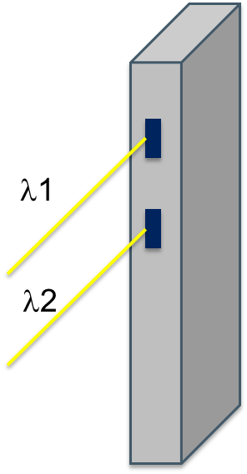
SW Defined Transponder
Single or Dual-Carrier Design
Mode 1 – Regional / LH
  100G: PM-QPSK
  200G: 2x100G, PM-QPSK
  ~ 10-12dB OSNR tolerance
  ~ 70,000 ps/nm CD tolerance
Mode 2 – Metro / Regional
  400G: 2x200G, PM-16QAM
  ~ 17-18dB OSNR tolerance
  ~ 30,000 ps/nm CD tolerance
37.5GHz for single carrier
75 GHz grid for dual-carrier
  25.6Tbps per fiber
Programmable latency (FEC)
Transmitter wave-shaping via DAC
Programmable latency / FEC
Drives need for flexible grid
Programmable transmitter wave-shaping

Slide 8
Programmable Capacity
Programmable capacity /flexible spectrum ROADM
37.5GHz channel plan
50GHz channel plan
75GHz channel plan
100Gbs
10Gbs
200Gbs
400Gbs

Slide 9
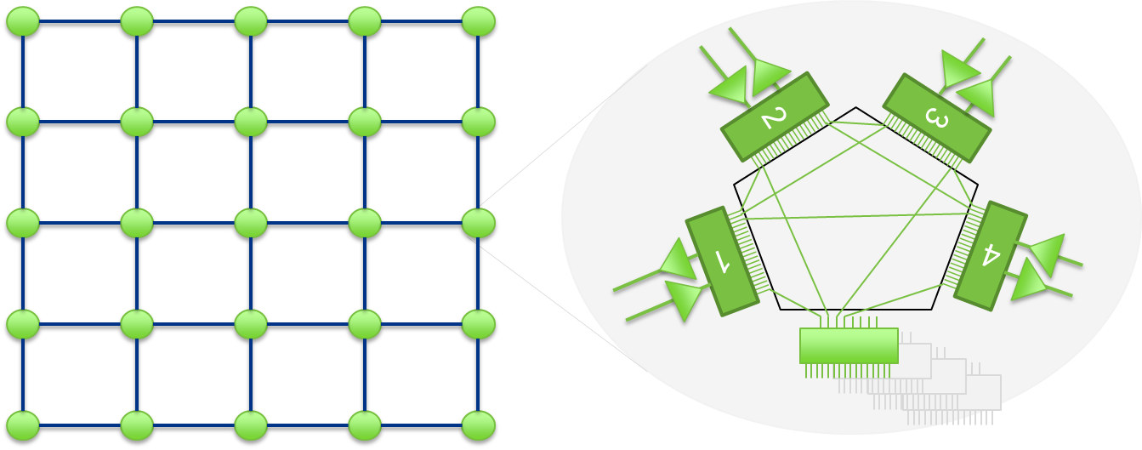
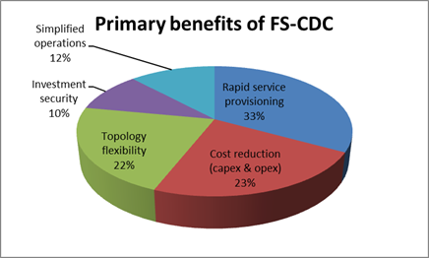
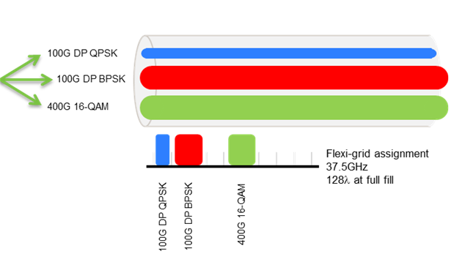
Programmable Connectivity
Flexible Grid CDC ROADM
Single bank of transponders of any color with service in any direction
Increased network automation
Simplified network planning
Flexible bandwidth on demand
Spectrum reallocation (defragmentation)
Optimal CAPEX & OPEX

Slide 10
Programmable Resources
Multi-layer Optimization
DC-to-DC traffic growing 10x faster than user traffic
Compute/storage resources distributed across multiple DCs
Bandwidth pressure, demand exceeds capacity
Optimize resources as one virtualized DC versus overbuilding for peak load
Massive scale,
low cost/bit
Dynamic traffic routing, low latency
Optimize cloud service performance
Allocate network resources based on application needs
Common POTS NE
Intelligent resource allocation per service demand
Virtualized packet transport
Flexible per service BW assignment
100G+ coherent i/f minimize CAPEX
Energy efficient to minimize OPEX
Link network intelligence & application control

Slide 11
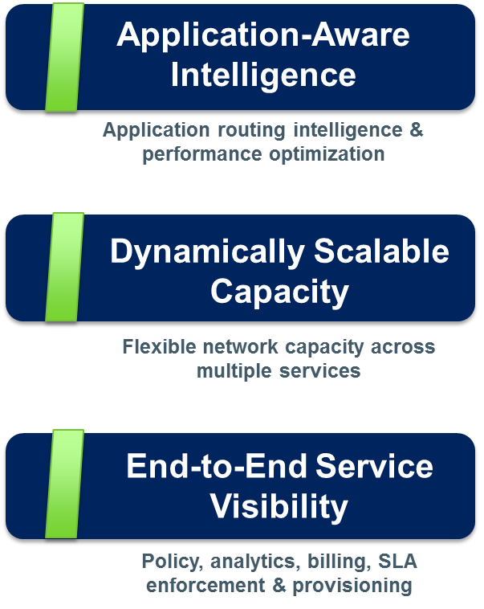




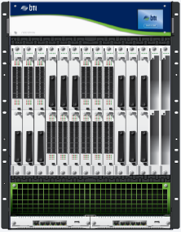






Intelligent Cloud Connect
Integrating Massive Scale With Applications Intelligence
Orchestration Software
Customer Orchestration Portals
BTI POC Portal
Customer Self Service Portal
Customer Application Portals
Open APIs
Control Applications
Cloud Control Applications
Packet Optical Control (POC)
Analytics
Control
Service Assur-
ance Control
Policy
Control
Open SDN Controller
Standard Interfaces
(e.g. OpenFlow, SNMP, NETCONF, XMMP)
Multi-GigE
MPLS
End-2-End LSPs
MPLS
App
App
App
Optical Circuits
App
App
App

