Slide 1
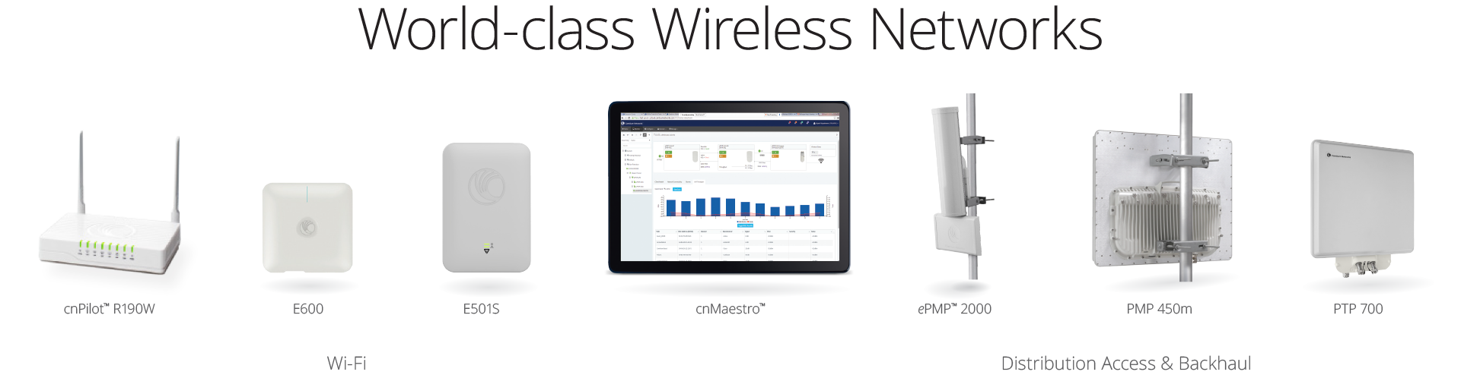
CAMBIUM NETWORKS
PTP PRODUCT PORTFOLIO

Slide 2
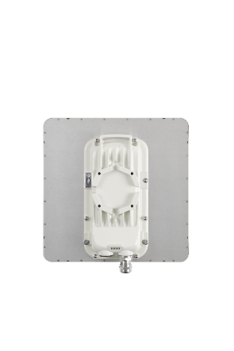
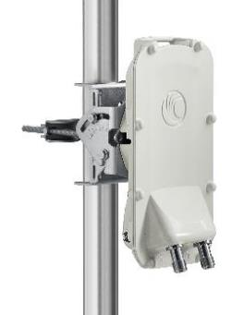
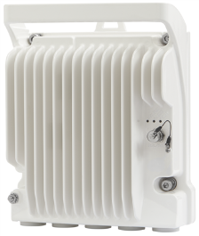
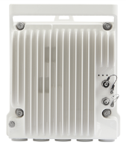
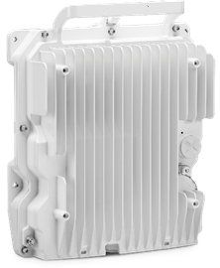
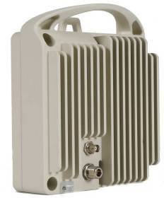
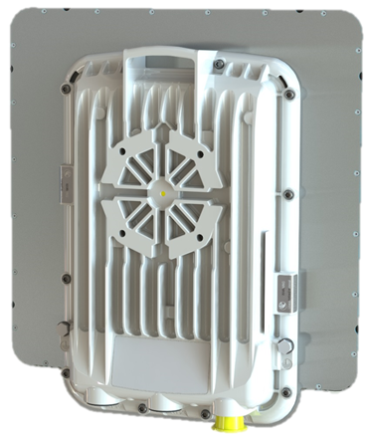
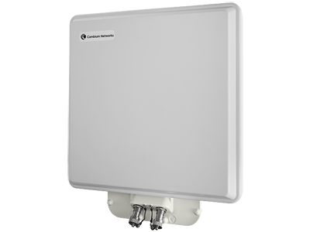
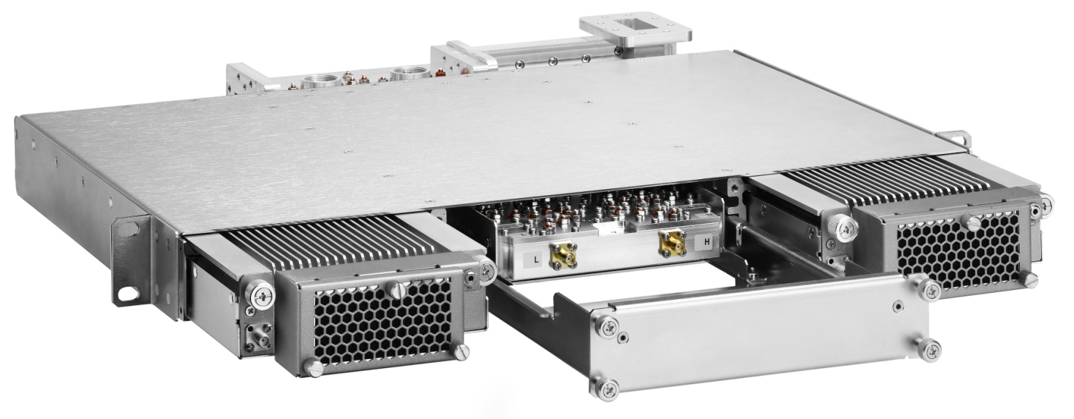
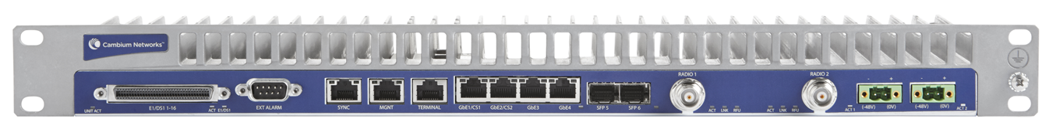
PTP Portfolio: Summary
Sub 6 GHz
Licensed Microwave
PTP 820S
PTP 820C
PTP 820C HP
PTP 450i
PTP 550
RFU-S-HP
RFU-C
RFU-A
PTP 670
PTP 700
PTP 820G

Slide 3
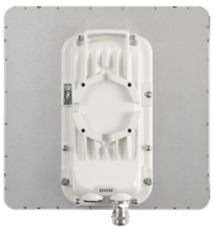
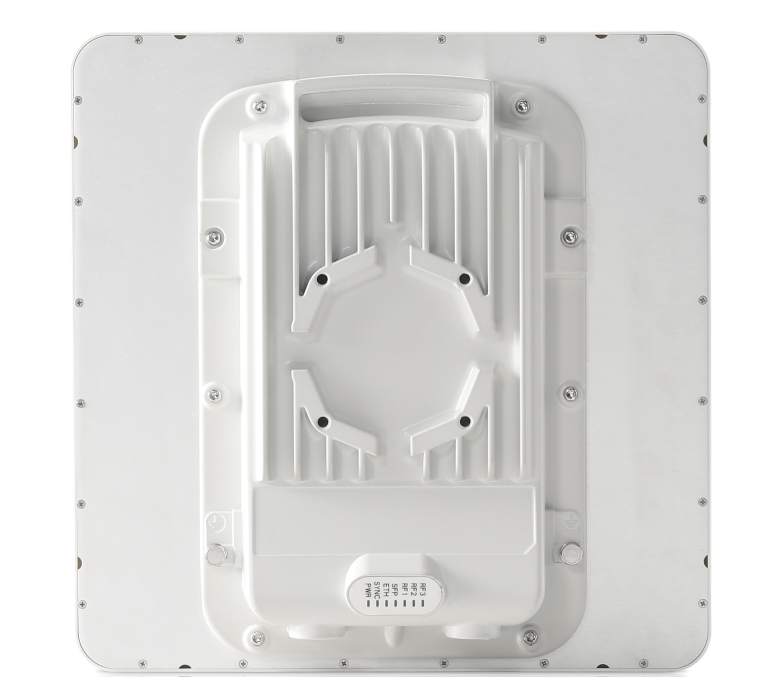
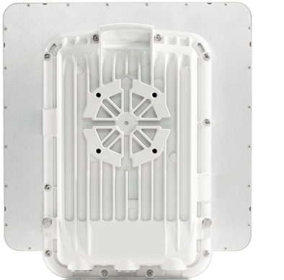
Sub 6 GHz Backhaul
PTP 450i
PTP 550
PTP 670
Comprehensive Network
High throughput Network
Resilient & Challenging Network

Slide 4
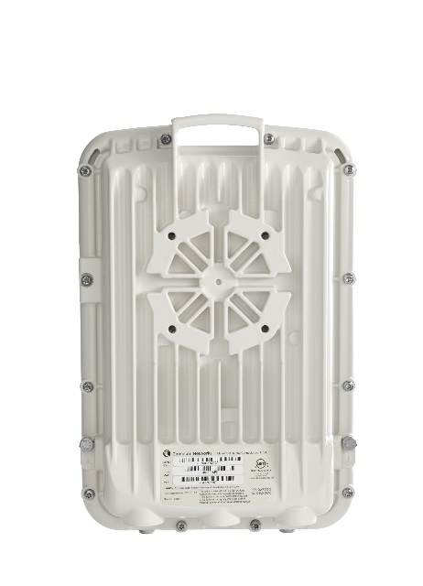
COMPARISON PTP 650 vs PTP 670
$ 995
$ 0
CAPACITY KEY
$2500
$2500
RADIO MSRP
PTP 650
$ 3495
$ 2500
PTP 670

Slide 5
HOW TO SETUP BACKWARD COMPATIBILITY
COMMON QUESTIONS:
Is PTP 670 backward compatible with PTP 600 ?
NO, it is not compatible
Is PTP 670 backward compatible with PTP PTP650, 650S & 650L ?
Yes, it is compatible
Can we have 2 PTP 650 with one firmware on 650-01-44 and another as 650-01-43 ?
YES, it can be configured this way
When is this backward compatible Firmware releasing ? Already released and available on Website
Is there is special price for this firmware ?
NO, this firmware is free
Will this specific firmware be upgrade to tip of firmware eventually ?
NO, there will be no development firmware releases
FIRMWARE 650-01-44
PTP 650
FIRMWARE 670-01-44
PTP 670

Slide 6
PTP Portfolio Analysis
PTP 670
Feature Richness
PTP 450i
PTP 550
Price

Slide 7
PTP Portfolio Analysis
PTP 670
Feature Richness
PTP 450i
PTP 550
Throughput

Slide 8
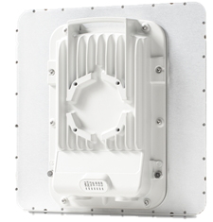
PTP 550 : High Throughput Network
Frequency Bands/Channels
5.1 GHz to 5.9 GHz
2 x 20 / 40 / 80 MHz channels
Aggregate Capacity
Up to 1.36 Gbps
Interfaces
1 x Ethernet 100/1000 BaseT with PoE
1 x SFP Slot
Adaptive Modulation
MCS-0 to MCS-9 with two streams(V+H)
Latency
3 - 6 ms
Maximum Power & Antenna Gain
27 dBm combined output power
23 dBi integrated antenna
Physical and Security
128-bit AES, HTTPS and SNMPv3
All Metal enclosure, IP67
Up to 1.36 Gbps Throughput with ARQ
Asymmetric non-contiguous channel aggregation across 5 GHz band
Built-in live spectrum analyzer, Dynamic Spectrum Optimization (DSO) enables to continually scan the band for low interference channels *
Small form factor, IP67 metal housing
TDD Sync using Cambium Sync
Support SFP interface

Slide 9
ASYMMETRIC CHANNEL BONDING: EXPLAINED
PTP 550
CHANNEL A
THROUGHTPUT
THROUGHTPUT
PTP 550
CHANNEL B
20
40
80
20
40
80
CHANNEL A
CHANNEL B
CHANNEL A | CHANNEL B | EXAMPLE SCENARIO | THROUGHPUT
20 | 20 | HIGH INTERFERENCE | 350 Mbps
20 | 40 | ONLY ONE CLEAN CHANNEL | 500 Mbps
80 | 20 | ONLY ONE CLEAN CHANNEL | 850 Mbps
40 | 40 | TWO CLEAN CHANNEL | 700 Mbps
40 | 80 | TWO CLEAN CHANNEL | 1 Gbps
80 | 80 | TWO FULL CLEAN CHANNEL | 1.4 Gbps

Slide 10
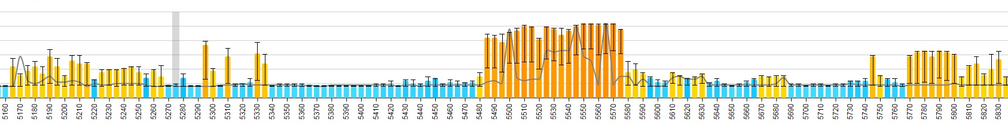
Resilient Network & Aggressive Network
CHANNEL A: SAFE and STABLE
RELIABLE/GURANTEED LINK to customers
CHANNEL A
PTP 550
PTP 550
CHANNEL B: AGGRESSIVE
Strive for better throughput for customers
CHANNEL B
RELIABLE
AGGRESSIVE
20 MHz
40 MHz
CHANNEL A
CHANNEL B

Slide 11
DFS Network & Non-DFS Network
CHANNEL A: DFS NETWORK
CHANNEL B: NON-DFS NETWORK
CHANNEL A
All traffic gets rerouted in case of DFS HIT from Channel A to Channel B, after DFS is resolved, radio is restored to original state of shared traffic between CHANNEL A & B
PTP 550
PTP 550
CHANNEL B
DFS NETWORK
NON DFS NETWORK
80 MHz
40 MHz
CHANNEL A
CHANNEL B

Slide 12
PTP 550 : KEY DIFFERENTIATING FEATURE
1.36 Gbps Headline Throughput
Asymmetric non adjacent Channel Bonding (Scenario Below)
DFS and Non-DFS
Aggressive and Resilient Network
Asymmetric modulation between two channel
Link Resilience:
Only 1 channel can move during DSO, hence link is always established
Small form factor and Metal enclosure : Durable
SPF port :
Commercial and Residential complex have fiber built in, hence easier to deploy
ARQ supported

Slide 13
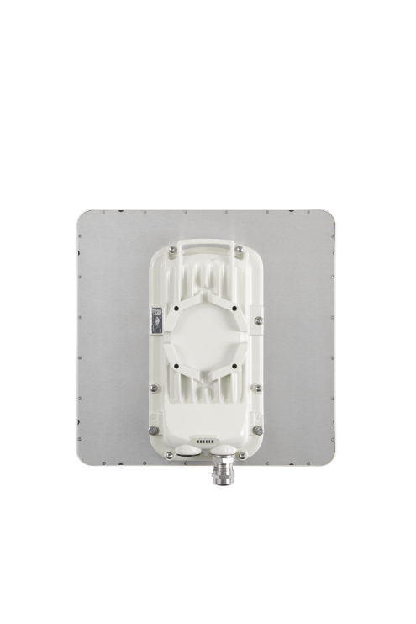
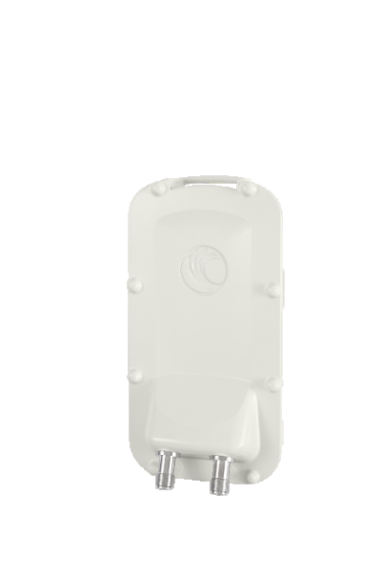
PTP 450i: Comprehensive Network solution
Frequency Bands/Channels
900 MHz, 3 GHz, 4900 – 5925 MHz
5, 7, 10, 15, 20, 30, 40 MHz
Aggregate Capacity
Up to 300 Mbps
Interfaces
1 x Ethernet 100/1000 BaseT with PoE
1 x Ethernet 100/1000 BaseT AUX Port with PoE Output
Adaptive Modulation
QPSK to 256QAM
Latency
3 – 5ms
Ouput Power & Antenna Gain
27 dBm combined output power
23 dBi integrated antenna
Physical and Security
128-bit AES, HTTPS and SNMPv3
All metal enclosure, IP 67
Max Throughput : 300+ Mbps @ 40 MHz channel
Multiple band options, including 900MHz, 3300 – 3900 MHz and 4900 to 5925 MHz with high processing power
Dynamic Filtering for optimal performance in high noise environments
Multi-function AUX port allowing to add camera, Wi-Fi hot spot, GPS Sync or alignment tone
ATEX/HAZLOC certified models for hazardous deployments
Notes:
Traditional Wi-Fi based OEM products typically offer filter designs that filter out signals that are outside the permitted range. They however do nothing to mitigate the interference from adjacent channel transmission, which is more common and a major cause of poor performance. Based on Cambium’s long experience in noisy outdoor environments, we’ve created filters that work across multiple channels. The dynamic filtering technology employed masks out all of the other channels but the channels of interest, markedly improving the clarity of the receiving signals, resulting in fewer retransmissions and higher throughputs across the board for all clients.

Slide 14

PTP 450i: ATEX and HAZLOC Certified
ATEX (Atmospheres Exposable) Equipment Group II
Category 3 / Zone 2
Gas Group IIC
Temperature Class T4
HAZLOC (Hazardous Locations)
Class 1 Location
Division 2
Gas Groups A, B, C, D

Slide 15
PTP 450i : KEY DIFFERENTIATING FEATURE
300 Mbps Headline Throughput
Narrow Channel Bandwidth supported including 5/10/15 MHz
Dynamic Filtering for optimal performance in high noise environments
Aux Port Supported can support
Wi-Fi Hotspot
Camera
GPS Sync
Single platform multiple solution
PMP 450i
PTP 450i
Public Safety (4.9 GHz)
ATEX/HAZLOC
ARQ supported

Slide 16
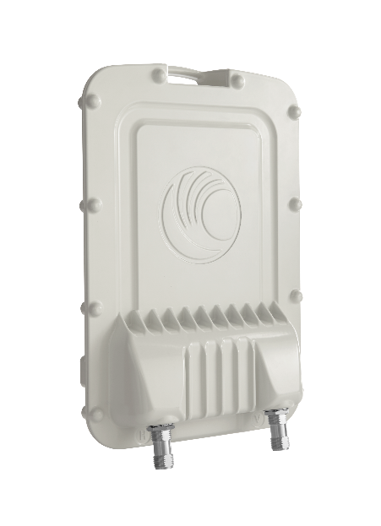
PTP 670 : Field Proven Reliability
Frequency Bands/Channels
4.9 GHz to 6.05 GHz
5, 10, 15, 20, 30, 40, and 45 MHz channels
Aggregate Capacity
450 Mbps, with 900k PPS
Interfaces
1 x Ethernet 100/1000 BaseT with PoE
1 x Ethernet 100/1000 BaseT with 802.3at PoE Output
1 x SFP slot port
8 x T1/E1 support with external Network Indoor Unit (NIDU)
Adaptive Modulation
BPSK to 256 QAM
Latency
1 – 3 ms
Output Power & Antenna Gain
27 dBm combined output power
23 dBi integrated antenna
Physical and Security
128-bit and 256-bit AES, HTTPS and SNMPv3
All metal enclosure, IP67
Support both PTP and HCMP (High Capacity MultiPoint)
450 Mbps Full Capacity by Default
Dynamic Spectrum Optimization (DSO) enables to continually scan the band for low interference channels
i-OFDM (intelligent Orthogonal Frequency Division Multiplexing) transmits over 1024 sub-carrier and results in high resilience to multi-path interference
Supports Non Line-of-Sight (NLOS) applications
Supports SyncE and 1588v2 Transparent Clock

Slide 17





HCMP Deployment Scenarios
Building to Building
Building to Street
Street to Street
Point To Point
(NLOS)
Macro Cell
Point To Point
(High Capacity Backhaul)
Macro Cell
Aggregation
Point
PTP 670
PTP 670
PTP 670 HCMP
PTP 670
Fiber to EPC
Street Level
Point to Point
Point to Point
(NLOS)
Copyright 2017 Cambium Networks, Inc. All Rights Reserved.

Slide 18
HCMP Mode: Explained
SCENARIO:
HCMP MASTER: 1
CONNECTORIZED PTP 670 + SECTOR ANTENNA
REMOTE NODES:
TWO INTEGRATED PTP 670
PTP 670
RM 1
Master
PTP 670
PTP 670
RM 2
GRAY: TX FREQUENCY
BROWN: RX FREQUENCY
Total Frame Capacity 360 Mbps
Master
Master
Master
Master
RM 1
RM 2
TDD 1:2 MODE
Master
Master
Master
Master
RM 1 RX
RM 1
RM 2
RM 2
TDD 1:1 MODE
*RN: Remote Node
*M : Master

Slide 19
PTP 670 : KEY DIFFERENTIATING FEATURE
450+ Mbps Headline Throughput
Best Spectral efficiency (Maximum Bang for your Buck): 10.1 bits/Hz
Narrow Channel Bandwidth supported including 5/10/15 MHz
850K Packets per second processing ideal for Backhaul solution
HCMP (High Capacity Multi-Point) supported
Topline security features
OTAR (Over the Air Rekeying)
AES 128/256 Encryption
Encrypt security parameters
Un-used port lock down
Multiple Level Access
Flexibility and Versatility built into Radio
Split frequency
Adaptive duty cycle
Supports IEEE 1588v2 and SyncE

Slide 20
PTP 450i vs PTP 550 vs PTP 670
RADIO COMPARISON | PTP 450i | PTP 550 | PTP 670
Frequency Range | 4.9 to 5.925 | 5.15 to 5.95 Ghz | 4.9 to 6.05 Ghz
Top Line Throughput | 300 Mbps | 1.36 Gbps | 450 Mbps
Channel BW Supported | 5/10/15/20/30/40 MHz | 2X 20/40/80 MHz(Up to 160 MHz) | 5/10/15/20/30/40/45 MHz
Efficiency | 7.5 bit/Hz | 8.5 bits/Hz | 10 bit/Hz
Packet Processing per second | 45 K pps | 100 K pps | 850 K pps
Antenna Gain | 23 dBi | 23 dBi | 23 dBi
Max Tx Power | 27 dBm | 27 dBm | 27 dBm
Latency | 3-5 ms | 3-6 ms | 1-3 ms
QOS | 3 Level /Diffserve 802.1q | 3 Level | 8 Level
Aux Port | Yes | No | Yes
SFP Port | No | Yes | Yes
Live spectrum analyzer | No | Yes | Yes
Sync-E | No | No | Yes
ARQ | Yes | Yes | No
Range | 125 Miles | 40 Miles | 155 Miles
IEEE 1588 V2 | No | No | Yes
IPv6 | Yes* | Yes | Yes
DSO Feature | No | Yes | Yes
HCMP | No | No | Yes
Encryption | AES 128/AES 256* | AES 128 | AES 128/ AES 256
Max Frame Size | 1500 | 1700 | 9600
IP Rating | IP67 | IP67 | IP67
*Roadmap

Slide 21
PTP vs RADWIN
ATTRIBUTES | ePMP F300 | PTP 450i | PTP 550 | PTP 670 | RADWIN 2000A | RADWIN 2000B | RADWIN 2000C | RADWIN 2000D+
List Price | $169 | $ 995 INT $895 CONN | $779 INT $649 CONN | $2,615 INT $2,395 CONN | $683 (17 dBi ) INT $788 (23 dBi) INT $ 473 (CON) | $1,365 (15 dBi) INT $1,575 (23 dBi) INT | $1,260 (23 dBi) INT $1,260 (21 dBi) INT $1,155 CONN | $1,600 INT $1,470 CONN
Channel Price Discount | 30% | 40% off | 40% off | 40% off | ? | ? | ? | ?
Max Throughput | 600 Mbps | 300 Mbps | 1.36 Gbps (2x80 MHz) 651 Mbps (2x40 MHz) 281 Mbps (2x20 MHz) | 450 Mbps | 100 Mbps | 200 Mbps | 200 Mbps | 750 Mbps
Spectrum Efficiency (bits/hz/s) | 7.5 | 7.5 | 8.5 | 10 | 2.5 | 5 | 5 | 9.375
Frequency Range | 5.15 to 5.97 | 4.9 to 5.925 | 5.15 – 5.96 | 4.9 to 6.05 | 4.8 to 5.9 | 4.9 to 6.06 5.89 to 6.410 | 4.9 to 6.06 5.89 to 6.410 | 4.9 – 6.09 GHz
Channel BW | 20/40/80 | 5/7/10/15/20/30/40 | 2x 20/40/80 | 5/10/15/20/30/40/45 | 5/10/20/40 | 5/10/20/40 | 5/10/20/40 | 5/10/20/40/80
Channel bonding | No | No | Yes | No | No | No | No | No
Top Modulation | 256 QAM | 256 QAM | 256 QAM | 256 QAM | 64 QAM | 64 QAM | 64 QAM | 256 QAM
PPS | 80,000 | 45,000 | 100,000 | 850,000 | ? | ? | ? | ?
Integrated Antenna | 25 dBi | 23 dBi | 23 dBi | 23 dBi | 17 or 23 dBi | 15 or 23 dBi | 21 or 23 dBi | 23 dBi
Latency | 3-6 ms | 3-5 ms | 3-6 ms | 2-4 ms | < 3 ms | < 3 ms | < 3 ms | < 3 ms
Tx Power | 27 dBm | 27 dBm | 27 dBm | 27 dBm | 25 dBm | 25 dBm | 25 dBm | 25 dBm
Jumbo Frame | 1700 Bytes | 1500 Bytes | 1700 Bytes | 9600 Bytes | 2048 Bytes | 2048 Bytes | 2048 Bytes | 2048 Bytes
Online Spectrum Analyzer | Yes | No | Yes | Yes | Yes | Yes | Yes | Yes
DSO | Potential | No | Yes (future) | Yes | No | No | No | Yes
Encryption | 128 AES | 128 AES | 128 AES | 128 & 256 AES | 128 AES | 128 AES | 128 AES | 128 AES
1588 Timing & SyncE | No | No | No | Yes | No | No | No | No
QOS | 3 Level | 2 Level | 3 Level | 8 Levels | 4 Level | 4 Level | 4 Level | 4 Level
PoE output | No | Yes | No | Yes | No | No | No | No
SFP Fiber Port | No | No | Yes | Yes | No | No | No | No
TDD Sync | Yes | Yes | Yes | Yes | Yes | Yes | Yes | Yes
TDM T1/E1 | No | No | No | Yes | Yes | Yes | Yes | Yes
IP Rating | IP55 | IP67 | IP67 | IP67 | IP67 | IP67 | IP67 | IP67
Power Consumption | 12 W | < 25 W | < 30 W | <30 W | 12 W | 25 W | 25 W | 25 W
Integrated Radio Dimension | 18" diameter x 12.2" depth | 12"x12"x2.5" | 12”w x 12”h x 2.2”d | 12"x13.5"x3.2" | N/A | 12”w x 12”h x 4”d | 12”w x 12”h x 4”d | 12”w x 12”h x 4”d
Connectorized Radio Dimension | N/A | 10.25"x5.25"x3.25" | 11”w x 7”h x 3.5”d | 8"x12.5"x3.5" | 7"x8"x3" | 11”w x 8”h x 3.5”d | 11”w x 8”h x 3.5”d | 11”w x 8”h x 3.5”d

Slide 22
Spec Comparison: PTP vs AirFiber
ATTRIBUTES | ePMP F300 | PTP 450i | PTP 550 | PTP 670 | Ubiqiti Airfiber 5x | Ubiqiti Airfiber AF-5U
List Price | $169 | $ 995 INT $895 CONN | $779 INT $649 CONN | $2,615 INT $2,395 CONN | $399 CONN | $999 INT
Channel Price Discount | 30% | 40% off | 40% off | 40% off
Max Throughput | 600 Mbps | 300 Mbps | 1.36 Gbps (2x80 MHz) 651 Mbps (2x40 MHz) 281 Mbps (2x20 MHz) | 450 Mbps | 500 Mbps | FDD : 1.2 Gbps TDD: 640 Mbps
Spectrum Efficiency (bits/hz/s) | 7.5 | 7.5 | 8.5 | 10 | 10 | 12.8
Frequency Range | 5.15 to 5.97 | 4.9 to 5.925 | 5.15 – 5.96 | 4.9 to 6.05 | 5.1 to 5.9 | 5.4 to 5.9 or 5.7 to 6.2
Channel BW | 20/40/80 | 5/7/10/15/20/30/40 | 2x 20/40/80 | 5/10/15/20/30/40/45 | 10/20/30/40/50 | 10/20/30/40/50
Channel bonding | No | No | Yes | No | No | Yes
Top Modulation | 256 QAM | 256 QAM | 256 QAM | 256 QAM | 1024 QAM | 1024 QAM
PPS | 80,000 | 45,000 | 100,000 | 850,000 | 1,000,000 | 1,000,000
Integrated Antenna | 25 dBi | 23 dBi | 23 dBi | 23 dBi | Dish Antenna | 23 dBi
Latency | 3-6 ms | 3-5 ms | 3-6 ms | 2-4 ms | < 2 ms | < 2 ms
Tx Power | 27 dBm | 27 dBm | 27 dBm | 27 dBm | 26 dBm | 26 dBm
Jumbo Frame | 1700 Bytes | 1500 Bytes | 1700 Bytes | 9600 Bytes | 9600 Bytes | 9600 Bytes
Online Spectrum Analyzer | Yes | No | Yes | Yes | Yes | Yes
DSO | Potential | No | Yes (future) | Yes | No | ?
Encryption | 128 AES | 128 AES | 128 AES | 128 & 256 AES | 128 AES | 128 AES
1588 Timing & SyncE | No | No | No | Yes | No | No
QOS | 3 Level | 2 Level | 3 Level | 8 Levels | Yes , ? Levels | Yes , ? Levels
PoE output | No | Yes | No | Yes | No | No
SFP Fiber Port | No | No | Yes | Yes | No | No
TDD Sync | Yes | Yes | Yes | Yes | Yes | TDD/FDD
TDM T1/E1 | No | No | No | Yes | No | No
IP Rating | IP55 | IP67 | IP67 | IP67 | IP67 | IP67
Power Consumption | 12 W | < 25 W | < 30 W | <30 W | 15W | 40W
Integrated Radio Dimension | 18" diameter x 12.2" depth | 12"x12"x2.5" | 12”w x 12”h x 2.2”d | 12"x13.5"x3.2" | N/A | 36"x18"x11"
Connectorized Radio Dimension | N/A | 10.25"x5.25"x3.25" | 11”w x 7”h x 3.5”d | 8"x12.5"x3.5" | 8.8"x3.23"x2" | N/A

Slide 23
Spec Comparison: PTP vs Mimosa B5
ATTRIBUTES | ePMP F300 | PTP 450i | PTP 550 | PTP 670 | Mimosa B5
List Price | $169 | $ 995 INT $895 CONN | $779 INT $649 CONN | $2,615 INT $2,395 CONN | $699 INT $499 CONN
Channel Price Discount | 30% | 40% off | 40% off | 40% off
Max Throughput | 600 Mbps | 300 Mbps | 1.36 Gbps (2x80 MHz) 651 Mbps (2x40 MHz) 281 Mbps (2x20 MHz) | 450 Mbps | 1.4 Gbps
Spectrum Efficiency (bits/hz/s) | 7.5 | 7.5 | 8.5 | 10 | 8.5
Frequency Range | 5.15 to 5.97 | 4.9 to 5.925 | 5.15 – 5.96 | 4.9 to 6.05 | 5.15 to 5875
Channel BW | 20/40/80 | 5/7/10/15/20/30/40 | 2x 20/40/80 | 5/10/15/20/30/40/45 | 2x 20/40/80
Channel bonding | No | No | Yes | No | Yes
Top Modulation | 256 QAM | 256 QAM | 256 QAM | 256 QAM | 256 QAM
PPS | 80,000 | 45,000 | 100,000 | 850,000 | 100,00
Integrated Antenna | 25 dBi | 23 dBi | 23 dBi | 23 dBi | 25 dBi
Latency | 3-6 ms | 3-5 ms | 3-6 ms | 2-4 ms | < 5ms
Tx Power | 27 dBm | 27 dBm | 27 dBm | 27 dBm | 30 dBM
Jumbo Frame | 1700 Bytes | 1500 Bytes | 1700 Bytes | 9600 Bytes | 3200 Bytes
Online Spectrum Analyzer | Yes | No | Yes | Yes | Yes
DSO | Potential | No | Yes (future) | Yes | Yes
Encryption | 128 AES | 128 AES | 128 AES | 128 & 256 AES | 128 AES
1588 Timing & SyncE | No | No | No | Yes | No
QOS | 3 Level | 2 Level | 3 Level | 8 Levels | 4 Level
PoE output | No | Yes | No | Yes | No
SFP Fiber Port | No | No | Yes | Yes | No
TDD Sync | Yes | Yes | Yes | Yes | Yes
TDM T1/E1 | No | No | No | Yes | No
IP Rating | IP55 | IP67 | IP67 | IP67 | IP67
Power Consumption | 12 W | < 25 W | < 30 W | <30 W | 20 W
Integrated Radio Dimension | 18" diameter x 12.2" depth | 12"x12"x2.5" | 12”w x 12”h x 2.2”d | 12"x13.5"x3.2" | 17.4" Diameter , 14.3"
Connectorized Radio Dimension | N/A | 10.25"x5.25"x3.25" | 11”w x 7”h x 3.5”d | 8"x12.5"x3.5" | N/A

