Slide 1

People Counting Installation Guide
ZheJiang Dahua Vison Technology CO.,LTD.

Slide 2
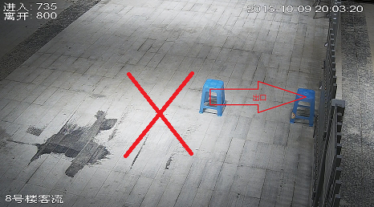
People Counting Analysis Report
【Scene】
Put the camera to the exit/entrance（oblique mounted），Or put the camera on the exit/entrance which is perpendicular to the ground(top mounted)，that is to analyze the object in and out real-time situation in the designated area. In the client end, it can be inquired the statistics of people counting volume in and out in specific date , month, year.
【Requirements】
1.Location
It should be to the flow direction（flow direction
is relatively uniform don’t have cross.）
It should be no obstructions in the field of view,
please choose the single background
texture background such as floor or walls, avoid the
light frequently changes, backlight,
direct sunlight scenes
Cover the width of people flow within 3 meters
Choose oblique mounted or top mounted：
Oblique Mounted：Safely monitored, scene requirement simple , less interference,
People counting volume shouldn’t be busy.
Top Mounted：Camera perpendicular to the ground, have height requirement that
guarantee to see the people pass by.
Note
Attention: Point selection is very important to directly influence the actual effect

Slide 3
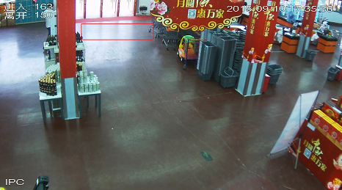
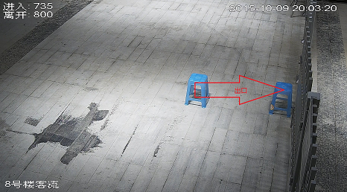
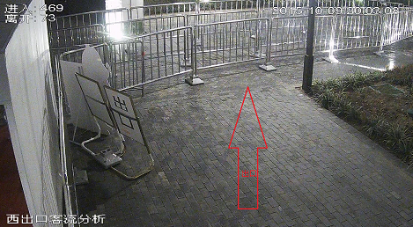
People Counting Analysis Report
Oblique Mounted：Height is H（H > 2.8m）
Horizontal distance f=2.8mm[1.26, 1.42]m
Horizontal distance f=12mm[5.04, 5.70]m
Top Mounted：Height is H（H > 3m）
The scene in unconformity：
People crisscross
Flow direction is not positive

Slide 4
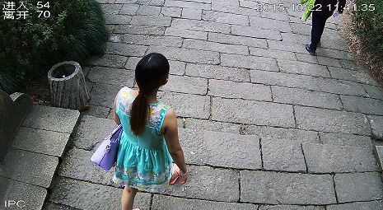
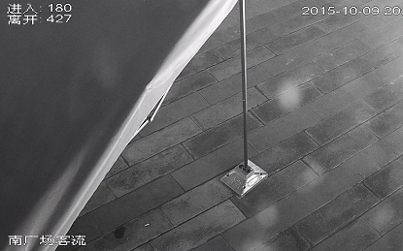
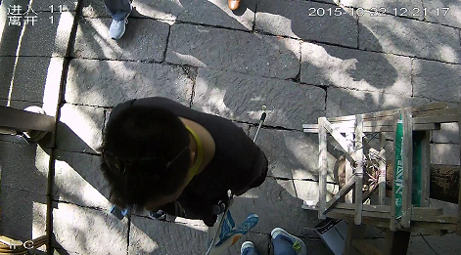
People Counting Analysis Report
Sample in unconformity：
Covered scenes
Height is too low, man’s head is
too big or incomplete

Slide 5
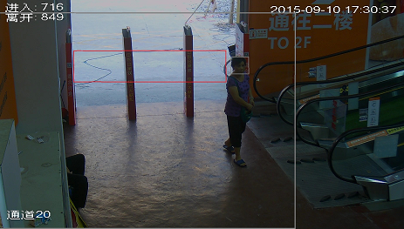
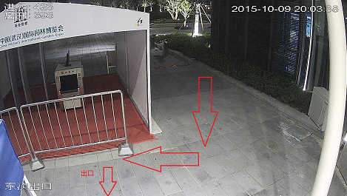
People Counting Analysis Report
Sample in unconformity：
Horizontal distance is too far, causing the man’s head is too small.
Statistical covering is more than width

Slide 6
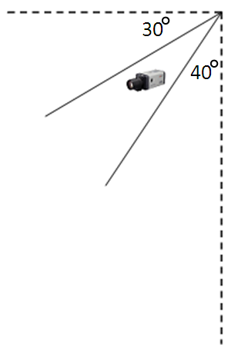
People Counting Analysis Report
2.Angle Adjustment
Oblique mounted：the angle between camera and horizontal should be 50 to 60 degrees (recommended 55 degrees).See beside picture
Top Mounted：install the device right above the count area，the degree between the camera and the vertical line should be less than 10 degrees , recommend 5 degrees
3.Focal Length Adjustment
Guarantee on the 1080p image, man’s head in the counting area width reach around 130 pixels.
Adjustment steps：
a. Screenshots
b. Open the draw tools
c. Re-adjust the size
d. Check the head size
（Oblique：under 320*240 head size:20-50px
Top：under 208*156 head size:20-50px ）

Slide 7
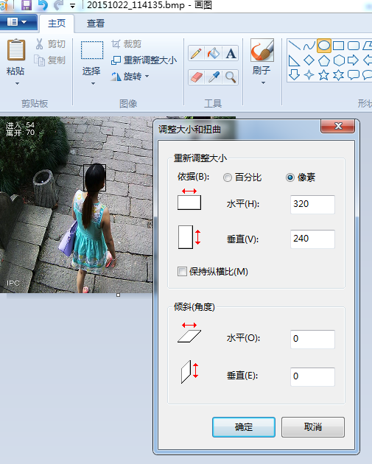
People Counting Analysis Report
4. WEB setup
a.Enable People Counting ->Exit/Entrance->Start
b. Enable People Counting->Exit/Entrance->Start OSD overlay
c. Set rules and direction “in” or “out”
d. Set People Counting volume alarm->People counting
e. Set trigger option
Note
Set rule box
Usually rule box is in the middle of the flow movement view, the width will cover exit/entrance width , height would be 2-3 heads width so that can guarantee people’s head completely in the rule box when pass by.
If the counting result is over actual result, please reduce the height of rule area properly; If the counting result is less than actual result, please increase the area height. The rule box shouldn’t be oversized to influence the performance.

Slide 8
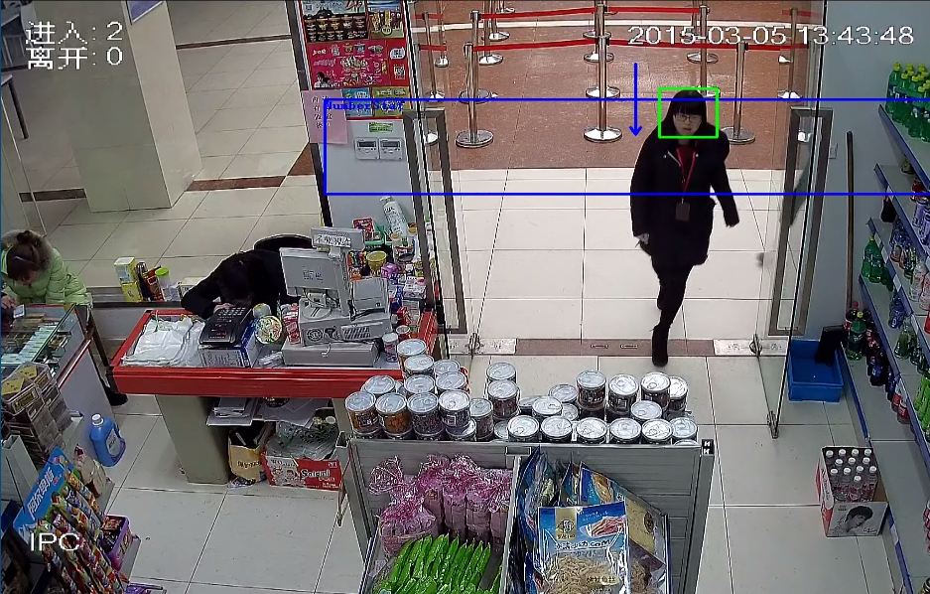
People Counting Analysis Report
Analyze the statistics of particular area that people in and out respectively：
●Reset settings page：It indicates the entered and left data of OSD overlay will be reset, the statistical data is not deleted . People counting strategy: zero reset, manual reset, change system time to another day reset
● In the report, the maximum capacity of data is 1 year, and it will be covered by hour automatically.
●Hardware goes to default will cause data loss.
Note

Slide 9
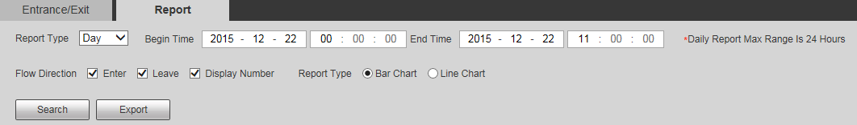
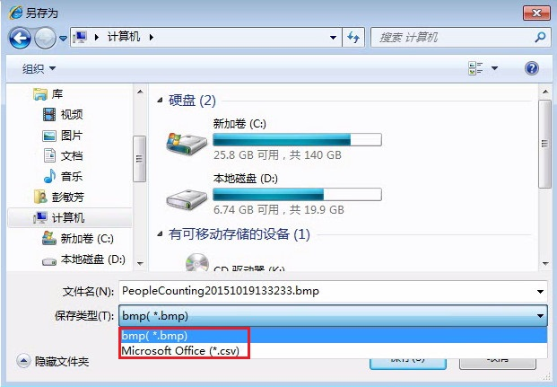
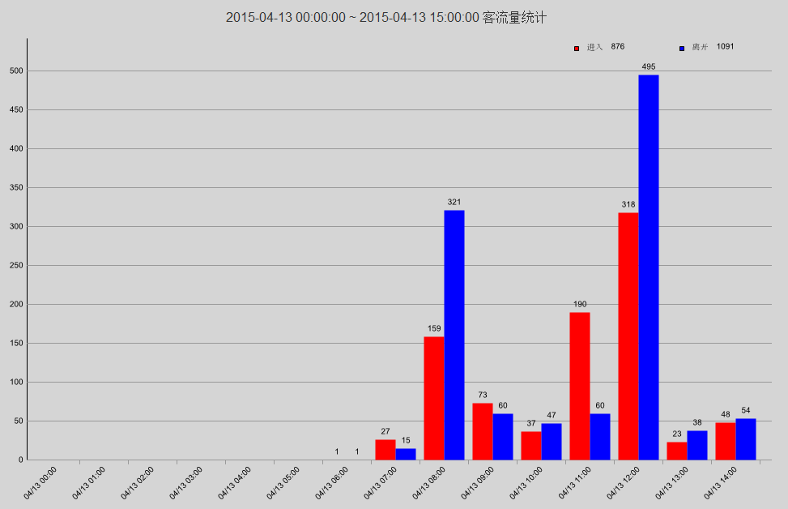
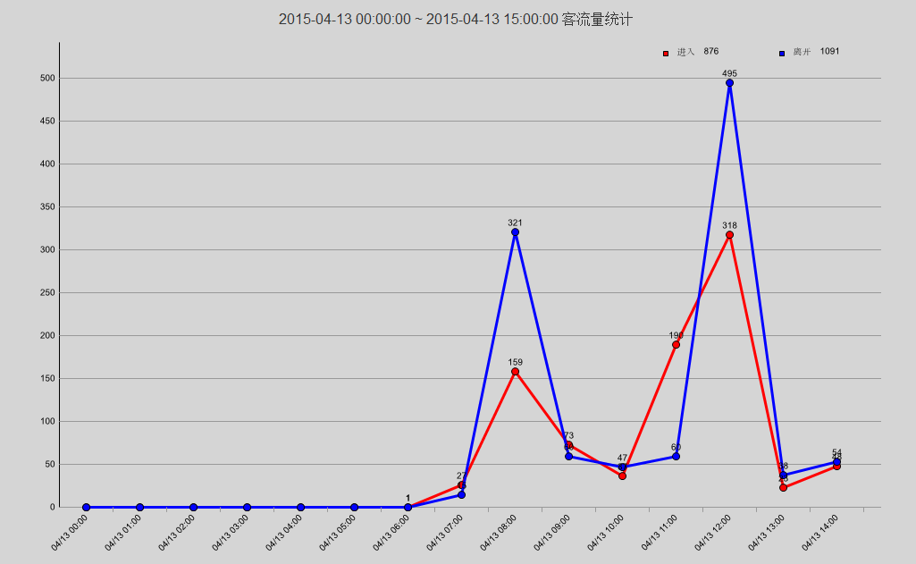
People Counting Analysis Report
Report type：bar chart, line chart
Export to save format：.bmp、.csv

Slide 10
THANK YOU!

