Slide 1

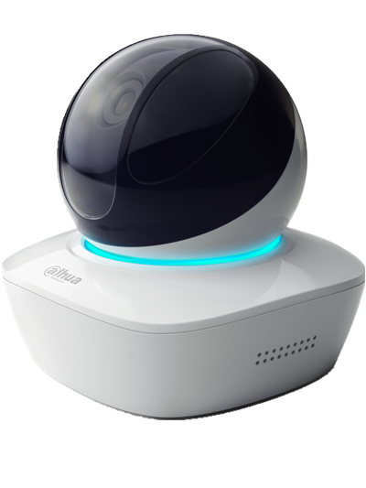
All I care about is your secured living
——A series Wi-Fi PT camera

Slide 2
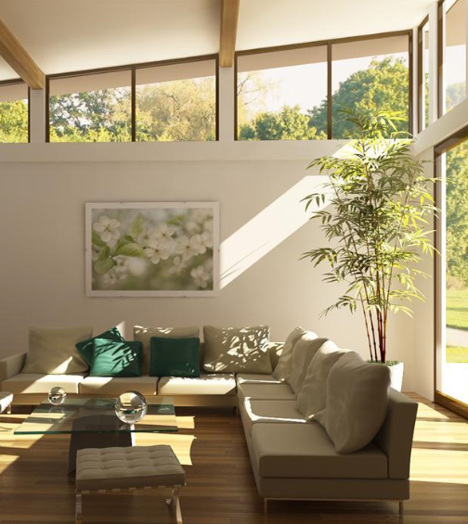


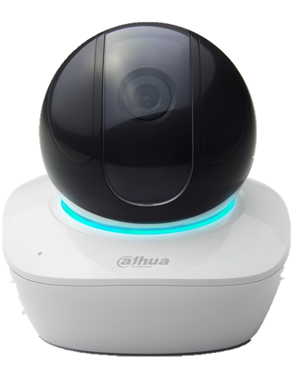
Overview
Appearance
PT
Wi-Fi
24/7 protection
Alarm notification
Two-way talk
Local storage

Slide 3
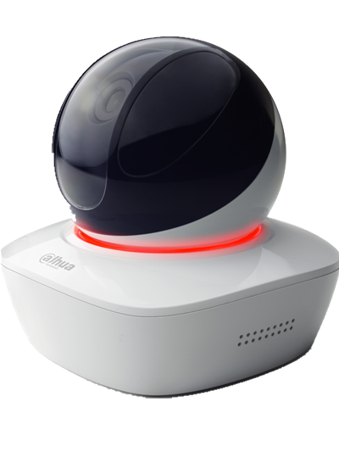
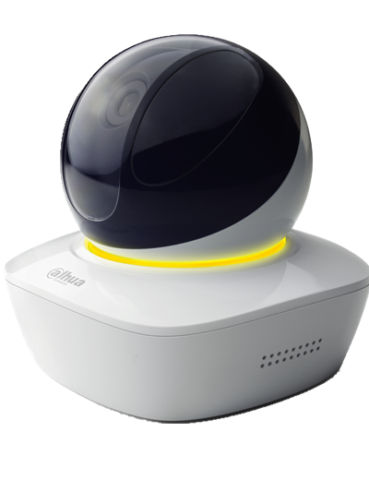
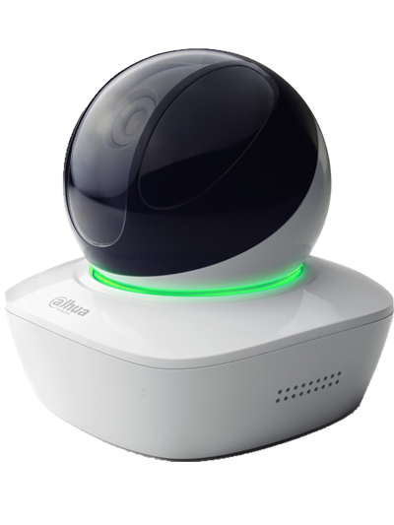
Appearance| Colorful light

Slide 4
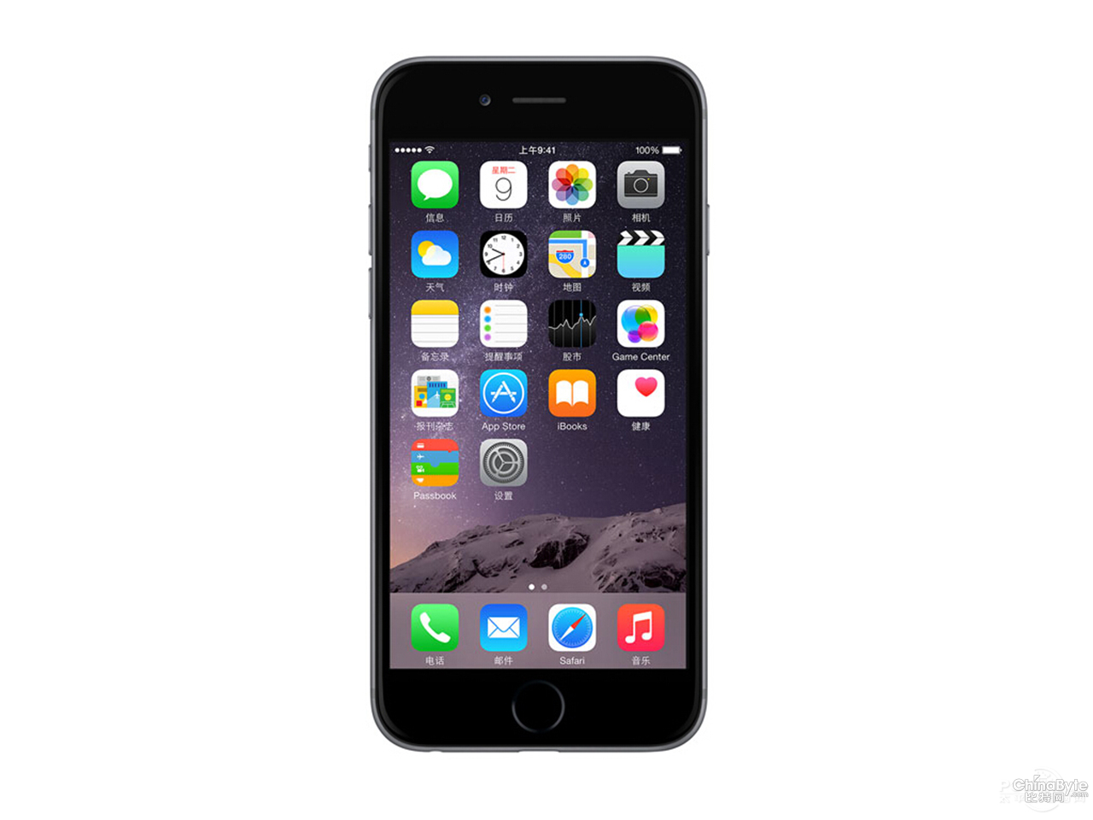
Appearance| Dimension
138.1mm
94mm
IPC-AW12W
iPhone 6

Slide 5
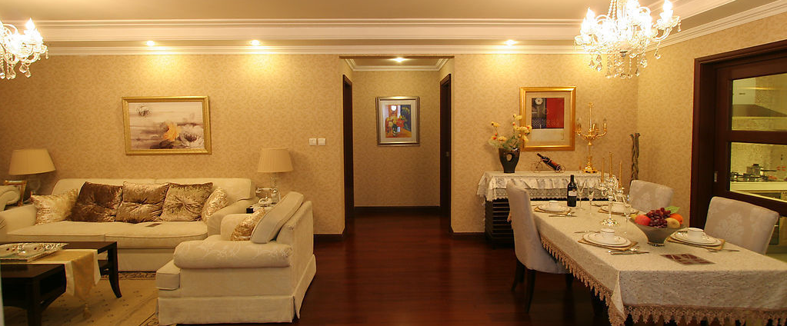

PT| 355°Pan, 90°Tilt
355°

Slide 6
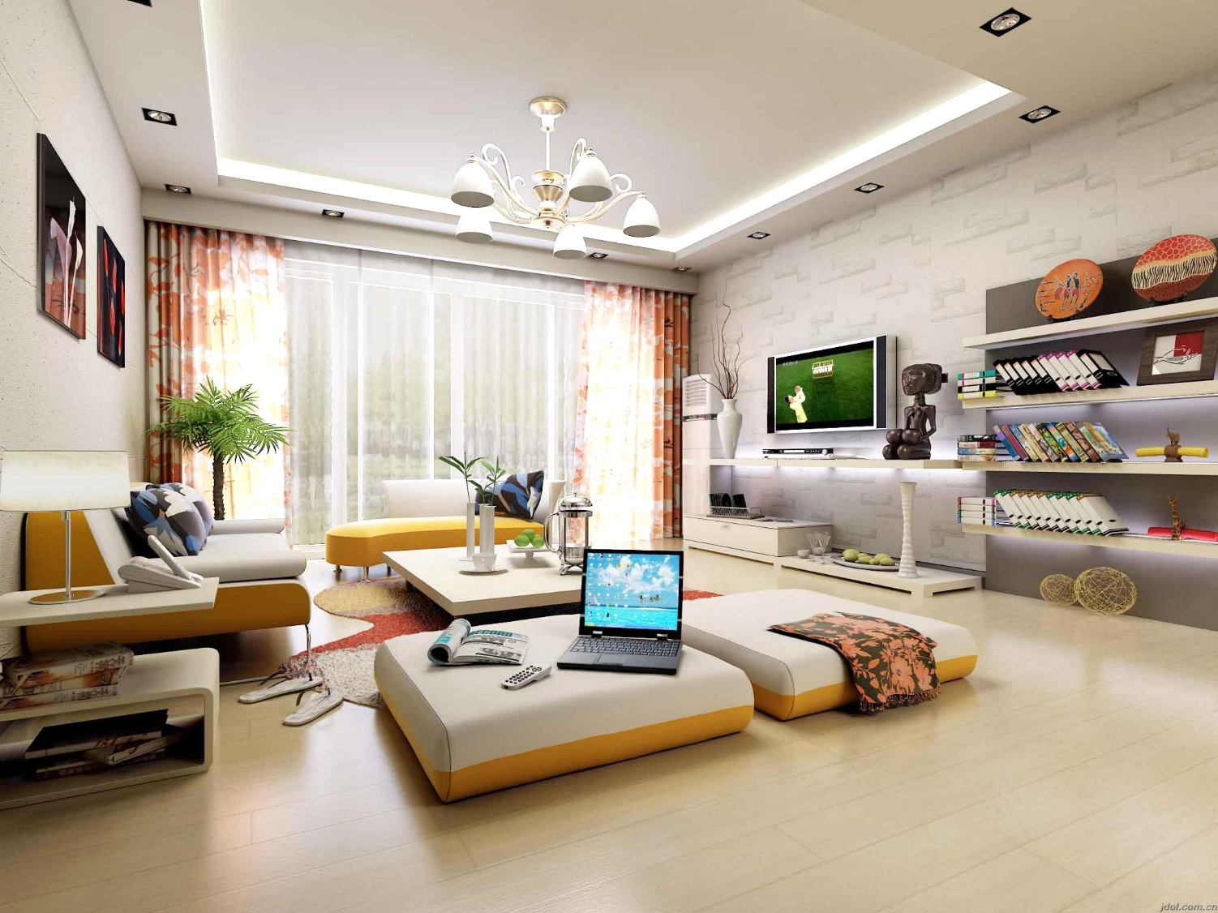

Wi-Fi| Away from Cable

Slide 7
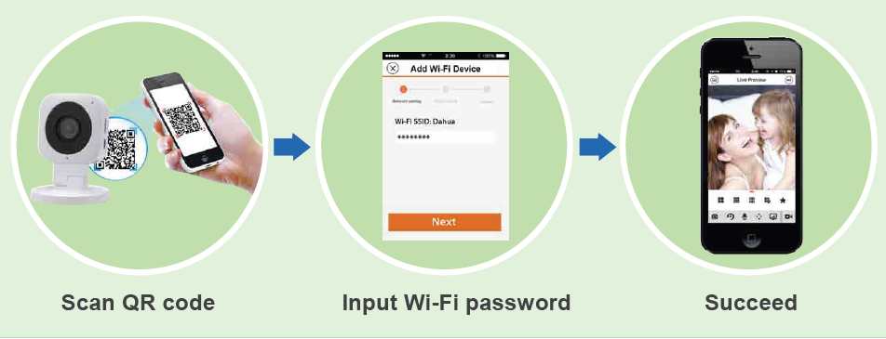
Wi-Fi| Smart Config
Easily connect to home Wi-Fi by operating DMSS APP.

Slide 8

24/7 Protection| Remote View
Monitor families anytime, even miles away with APP.

Slide 9

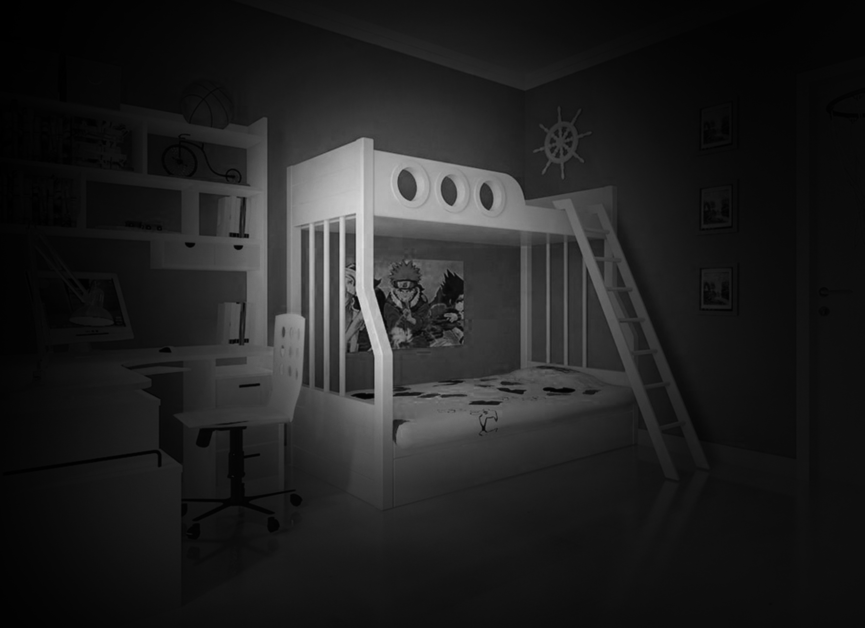
24/7 Protection| Night Vision
Feel safe even in total darkness.

Slide 10
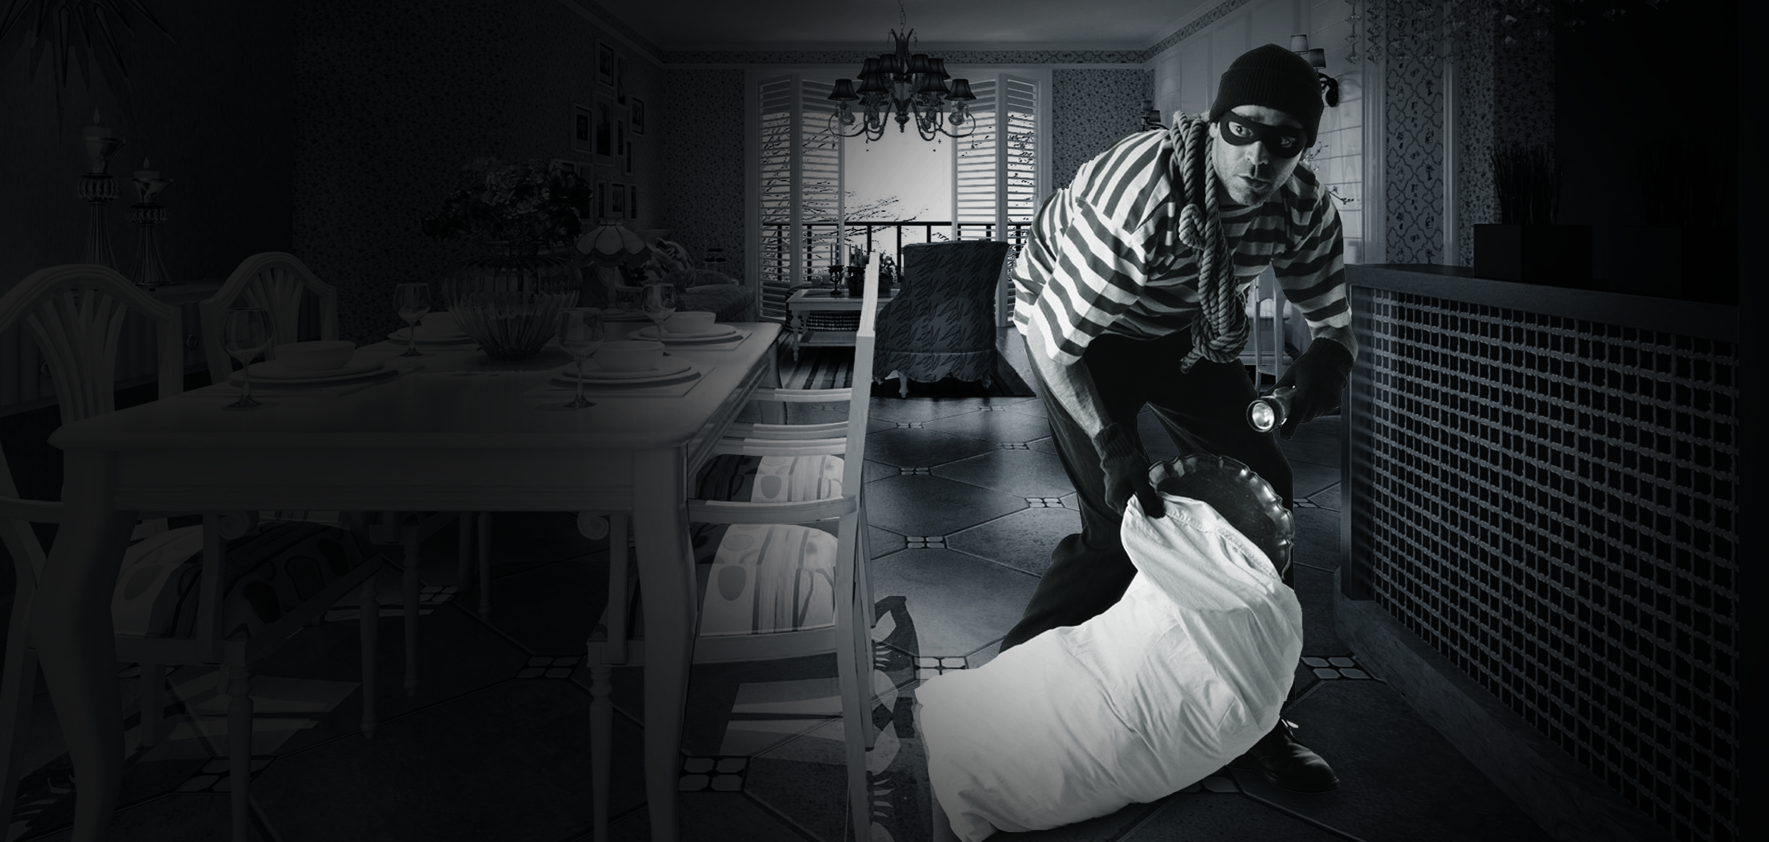
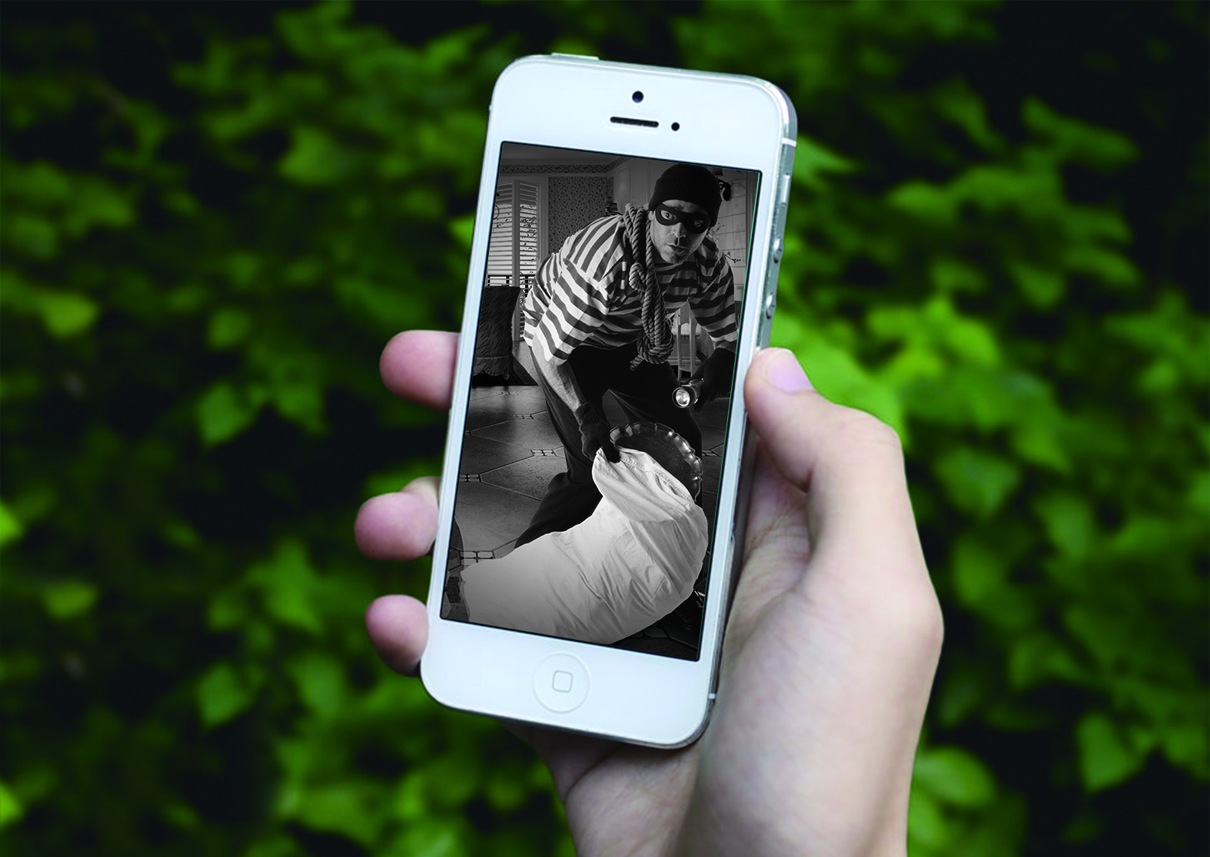
24/7 Protection| Alarm
Get push notification instantly when motion is detected .

Slide 11


Two-way Talk
High quality built-in Mic and Speaker.
WW~
Honey~

Slide 12
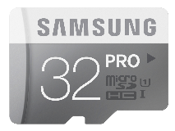

Local Storage| Mirco SD Card
Safe video record locally, no detail missed.

Slide 13
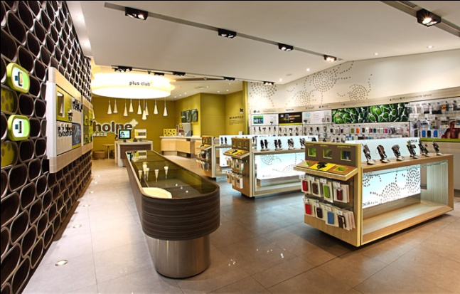
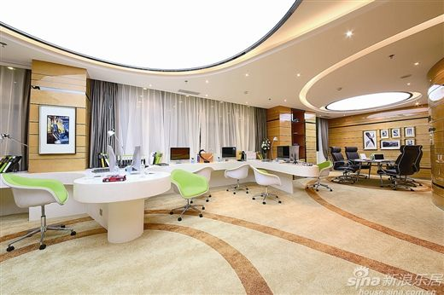
Application
Retail Store
Home

Slide 14

THANK YOU!
www.dahuasecurity.com

