Slide 1

1
Access ANPR System
Part

Slide 2
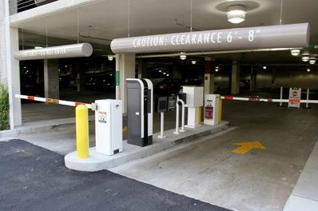
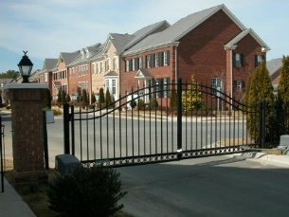
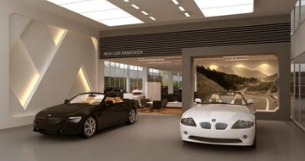
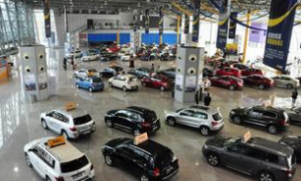
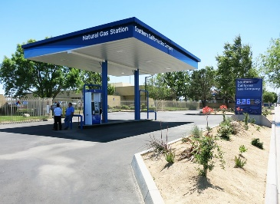
Applications Overview
Parking
Building Access
01
02
Applications
Car life: Car inspection, Car repair, Car rental, Gas station
03

Slide 3


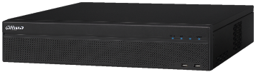
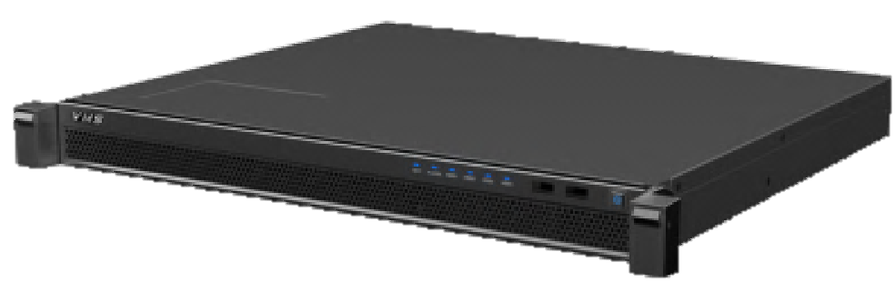
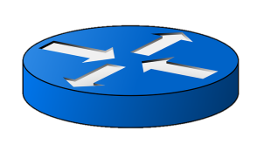
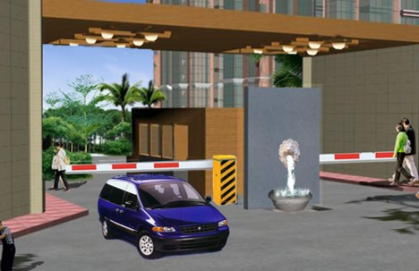

System Topology
PC Client
NVR
DSS Software
--Manage large scale system
Entry
Exit
ANPR Camera
ANPR Camera

Slide 4
System Feature
Performance
Capture Rate 98%
Accuracy Rate:95%
Function
LPR embedded
in camera
License plate search & video linkage
White List/ Black List
Barrier Linkage

Slide 5
2
Product highlights
Part

Slide 6
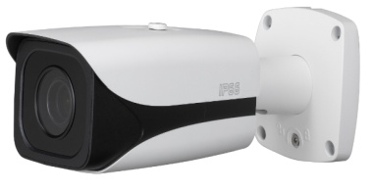

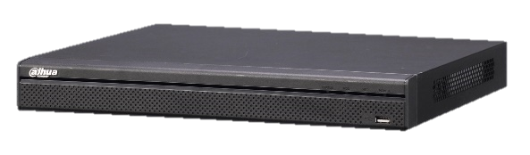
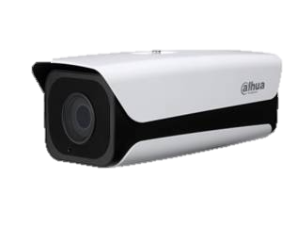
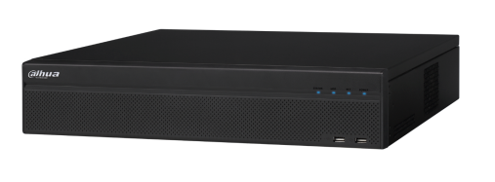
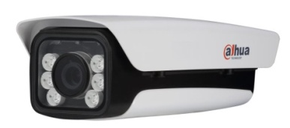
Products Composition
Access camera
NVR
Software
2 MP Access Camera (Short-focus)
2 MP Access Camera (Long-focus)
4 series NVR
6 series NVR
DSS4004
API for LPR

Slide 7
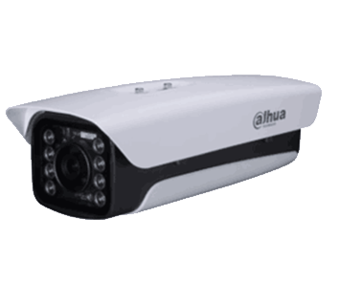
Access LPR Camera
----Simple LPR for your commerce

Slide 8
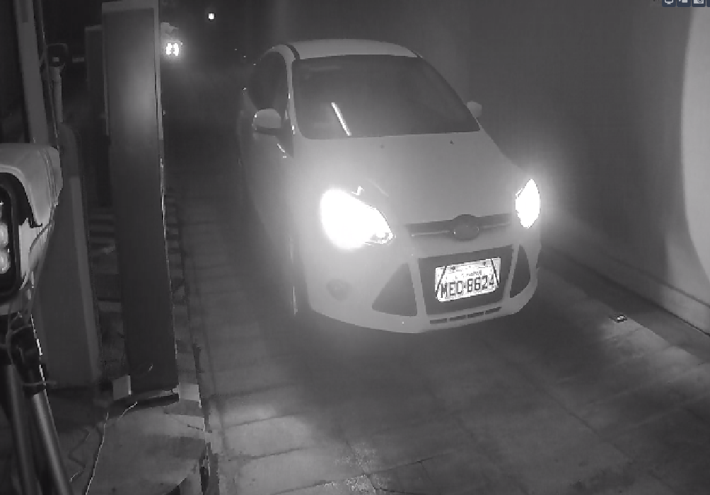
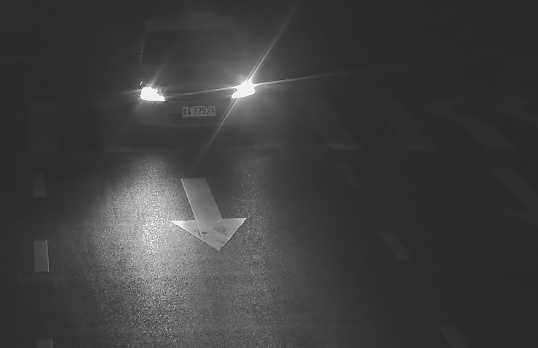
Access ANPR| Perfect image at night time
Head Light Handle
50KMH, 40M

Slide 9
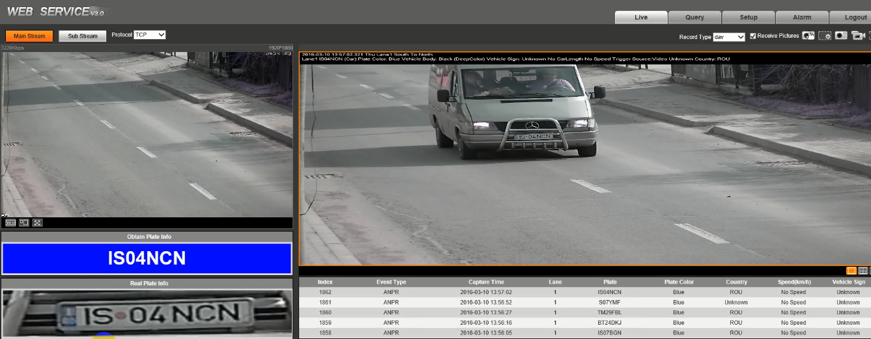
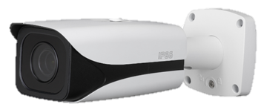
Access ANPR| OCR on board
LPR
Plate Result
Original snapshot
Camera Web
Vehicle Speed in 50KMH
Snap cut
Plate result list

Slide 10
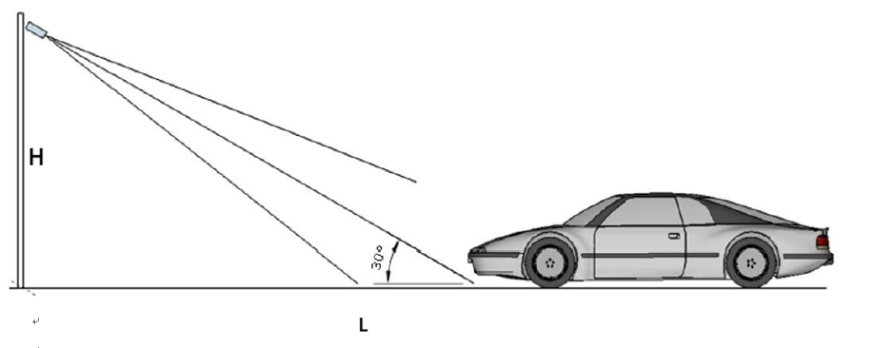
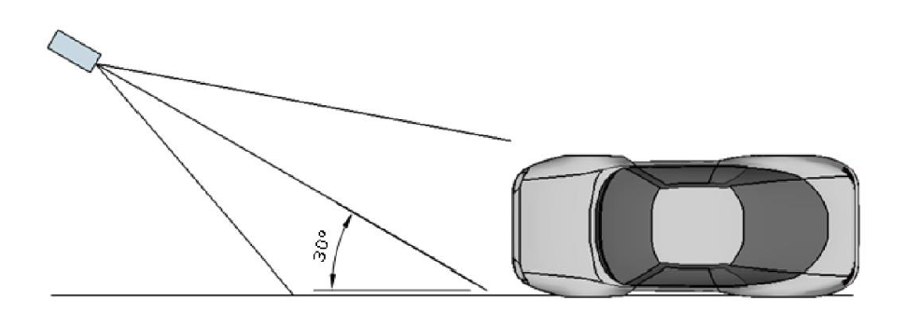
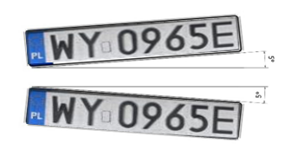

Access ANPR| Easy Installation
Vertical Angle<30 Degree
Horizontal Angle<30 Degree
LP Angle<5 Degree
LP width : more than 130pxel

Slide 11
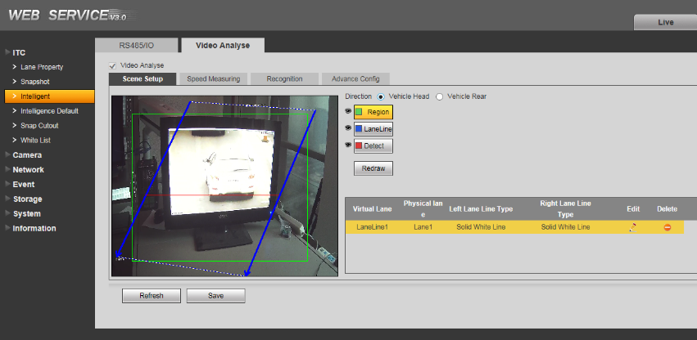
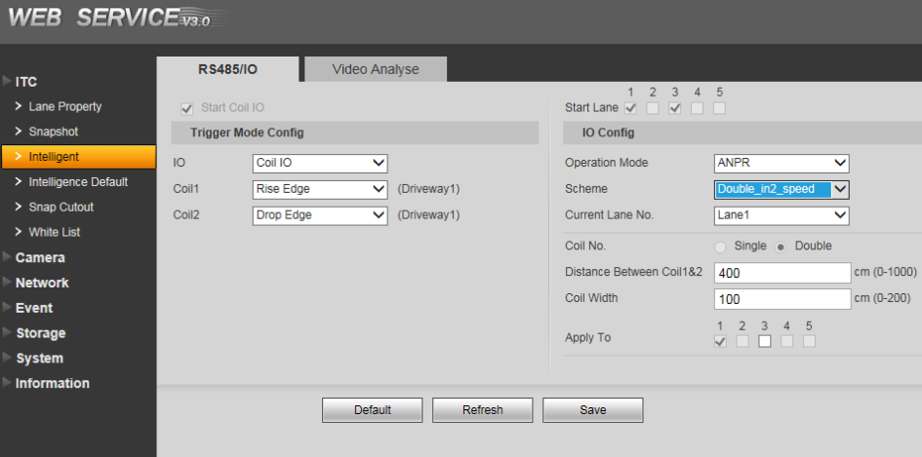
Access ANPR| Easy Configuration
Draw the detection area
Define the lane line
Reliable loop detection
Video Detection
Loop Detection

Slide 12
NVR
Easily manage the LPR data

Slide 13
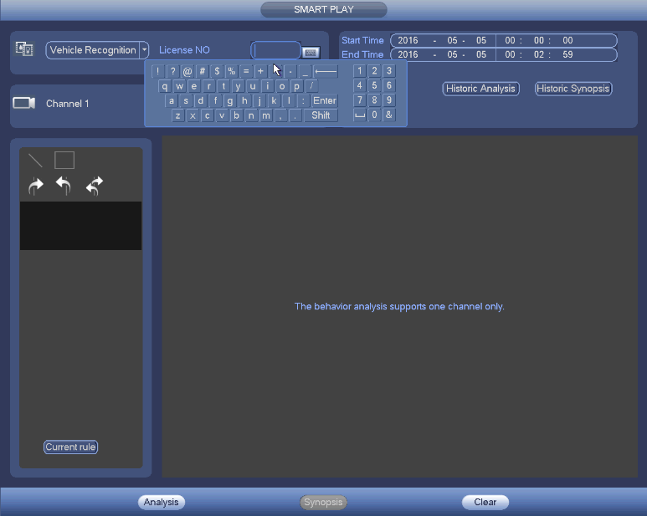
NVR| Search picture & linked video with plate
Fuzzy Search
NVR Web
Fuzzy Search
Search with plate, time

Slide 14
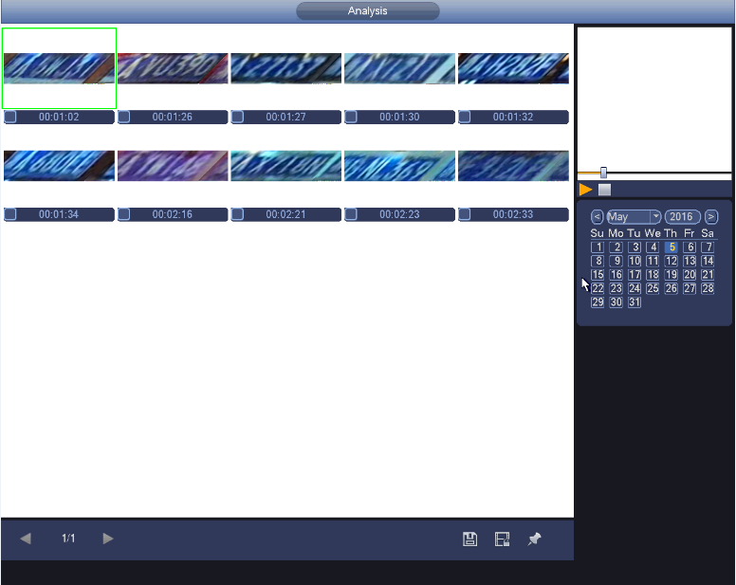
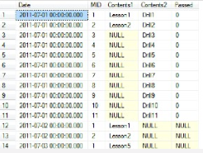

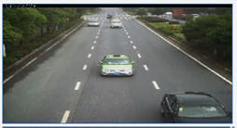

NVR| Search picture & linked video with plate
Robust DB
Snap Cut
Linked Video
50 thousand data list
NVR Web
Search 100 pictures within
2 seconds

Slide 15
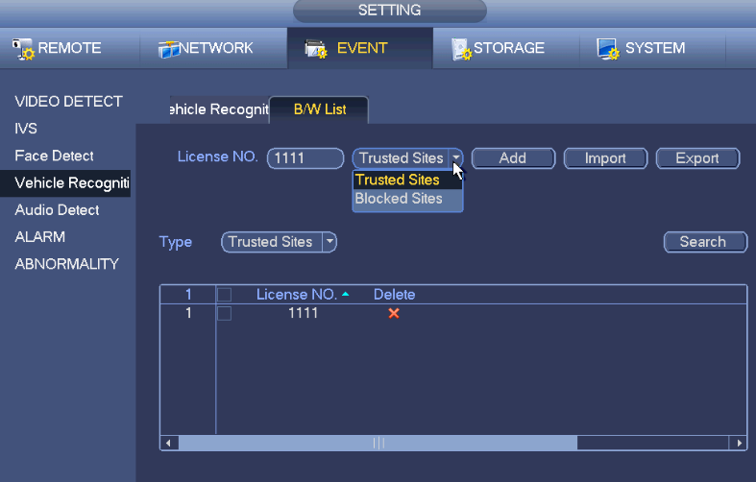
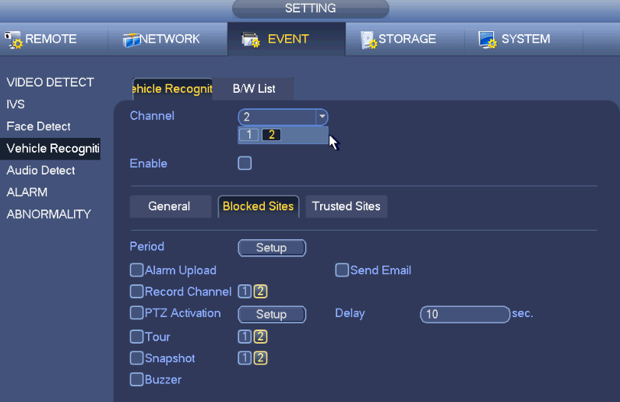
NVR| White & Black list
Black & White list
Batch import
Linkage of White & Black list
Black & White list record

Slide 16
Center Management Software
Professional in the large scale system

Slide 17
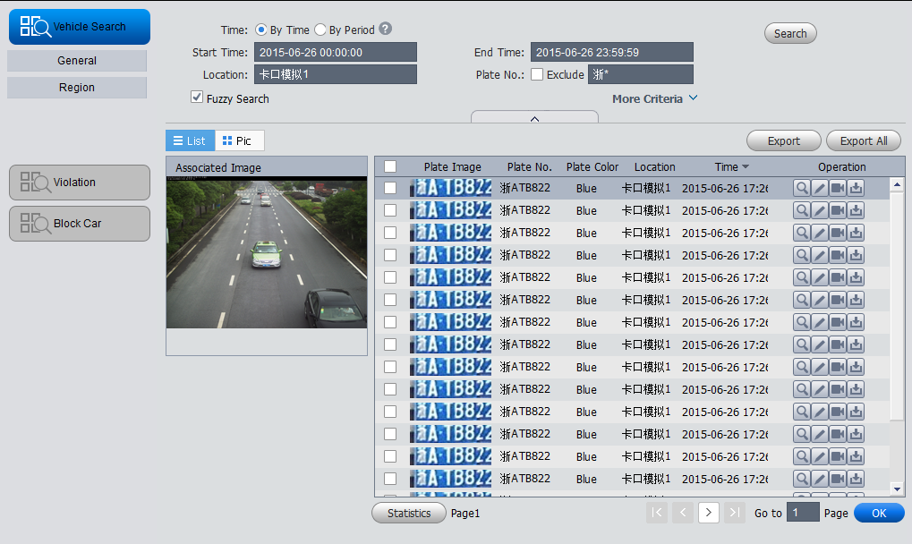
DSS | Search the picture linked video with plate
Fuzzy Search by number
Snap Cut
Plate Number
DSS-T
Embedded with Mysql
Search 1000 pictures within 2 seconds
Linked Video
Original Snapshot

Slide 18
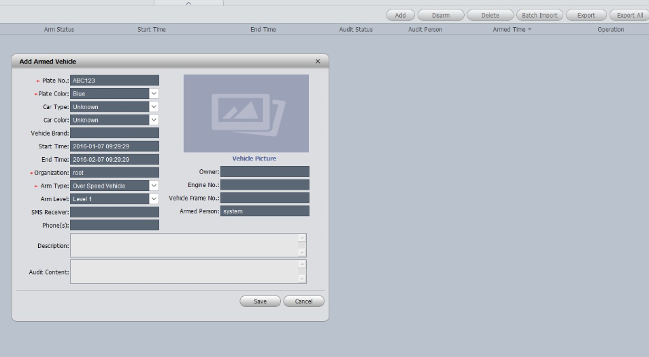
DSS | Black list
Batch import the black list
Black list record
DSS-T
Million White & Black list
Detail Info of black list

Slide 19
3
Main Products
Part

Slide 20
Access ANPR | Star Series
2MP Starlight LPR Camera(Long focus lens)
All-in-One device
IR, white lighting optional.
High Resolution and frame rate：
ITC237： 1920*1080 , 60fps
IR length: 8-40 meter, focus lens: 5-50mm, cover 8-40 meters for LPR.
Good image: 140db WDR, 0.005lux/F1.65 (Color), see the plate clearly in motion even at night.
Intelligent : LPR embedded, white list inside, relay out to control the barrier
Industry design: Embedded cooling-fan, heater make the working temperature - 40 ℃ ~ 70 ℃
API for LPR: SDK, CGI
Hot
Model:
ITC237-PU1A-IRL
(L/-IRL optional)
Applications：ANPR for access and barrier control

Slide 21
Parking Products| Access Camera
2MP Starlight LPR Camera(Short focus lens)
Hot
All-in-One device
IR lighting optional.
High Resolution and frame rate：
ITC237： 1920*1080 , 60fps
IR length: 4-8meter, motorized lens,4-8mm, cover 4-8 meters for LPR.
Working temperature: - 30 ℃ ~ 60 ℃
Good image: 140db WDR, 0.005lux/F1.65 (Color), see the plate clearly in motion even at night.
Intelligent : LPR embedded, white list inside, relay out to control the barrier
API for LPR: SDK, CGI
Model:
ITC237-PW1A-IRZ
Applications：ANPR for access and barrier control

Slide 22
Parking Products| Access Camera
2MP LPR Camera(Long focus lens)
All-in-One device
IR lighting optional.
High Resolution and frame rate：
ITC217： 1920*1080 , 30fps
IR length: 8-40 meter, motorized lens,4.7-47mm, cover 8-40 meters for LPR.
Working temperature: - 30 ℃ ~ 60 ℃
Good image: 120db WDR, 0.01Lux/F1.4(Color) ,see the plate clearly in motion even at night.
Intelligent : LPR embedded, white list inside, relay out to control the barrier
API for LPR: SDK, CGI
Hot
Model:
ITC217-PW1B-IRLZ10
Applications：ANPR for access and barrier control

Slide 23
Parking Products| Access Camera
2MP LPR Camera(Short focus lens)
All-in-One device
IR lighting optional.
High Resolution and frame rate：
ITC217： 1920*1080 , 30fps; ITC417: 2688x1520, 20fps
IR length: 4-8meter, motorized lens,4-8mm, cover 4-8 meters for LPR.
Working temperature: - 30 ℃ ~ 60 ℃
Good image: 120db WDR, 0.01Lux/F1.4(Color) ,see the plate clearly in motion even at night.
Intelligent : LPR embedded, white list inside, relay out to control the barrier
API for LPR: SDK, CGI
Model:
ITC217(417)-PW1B-IRLZ
Applications：ANPR for access and barrier control

Slide 24
NVR | Star Series
6 series Super NVR
16 channel ip cameras, 16 channel ITC cameras.
Max 384Mbps incoming bandwidth
Search model: Time/Date, fuzzy or accurate plate number.
Interface:1 VGA+2 HDMI, 8 ch relay out.
Reliable: Support RAID 0/1/5/6/10/50/60, N+M hot standby
Black & White list: Support bulk import
Compatibility : ONVIF Version 2.4 conformance, multiple third part IP camera
Trigger events: Recording, PTZ, Tour, Alarm out, Video Push, Email, FTP, Snapshot, Buzzer & Screen tips
API for LPR: SDK, CGI
Hot
Model:
NVR608-32-4K
Applications：Manage the LP data, search, store, etc

Slide 25
NVR | High Cost Performance Choice
4 series NVR
4 channel ip cameras, 4 channel ITC cameras(4 series).
Max 200Mbps incoming bandwidth
Search model: Time/Date, fuzzy or accurate plate number.
Interface:1 VGA+1 HDMI, 3 ch relay out.
Black & White list: Support bulk import
Compatibility : ONVIF Version 2.4 conformance, multiple third part IP camera
Trigger events: Recording, PTZ, Tour, Alarm out, Video Push, Email, FTP, Snapshot, Buzzer & Screen tips
Power: 8 ports (IEEE802.3at/af) (for -8P model)
Model:
NVR4208-8P
Applications：Manage the LP data, search, store, etc

Slide 26
DSS | Star Series
DSS4004-T
Video embedded Linux machine, 30 * 24 hours stable operation
Max support 500-ch input, 200-device input, 50 LPR channel
Support single input of 300Mbps, forwarding of 300Mbps, and storage of 100Mbps.
2 local hard disks
Support distributed stack and cascading application
Support ONVIF standard protocol
Provide platform SDK
Hot
Model:
DSS4004-T
Applications：Manage the LP data, search, store, etc

Slide 27
Thanks!

