Slide 1

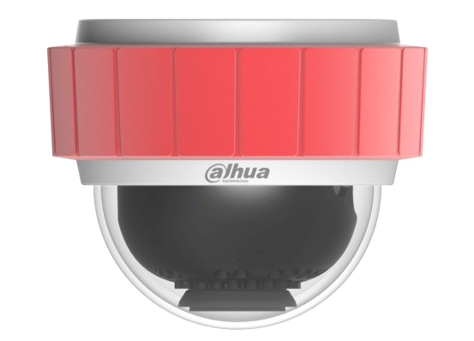
Parking Detection Camera
Your best choice of parking assistance

Slide 2
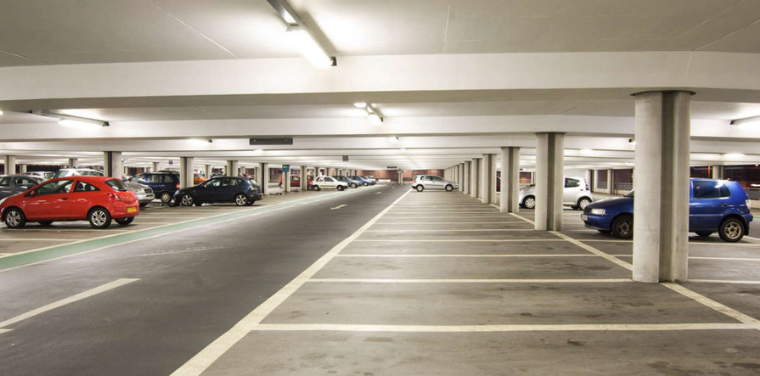
Draw a Innovative parking map for you only!

Slide 3
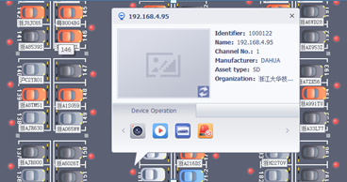
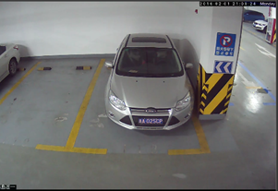
What is innovation?
Ultrasonic Sensor
Camera Detection
Open the eye of parking operator

Slide 4
What is innovation?
Personal (?)
Personal (?)
Public
Public
Disabled
(?)
Disabled
(?)
Public
Public
Ultrasonic
A:Who parks here?
B: Nobody knows!!!
Camera
A:Who parks here?
B: ABC1234
A: No, it’s not a personal plate, get out!!!
Read vehicle feature like plate
to confirm If it’s a car allowed parking.

Slide 5




Camera is innovation
will be a Policeman
will be a Inspector
Please take me to your park.
will be a Guider
•••••••••
•••••••••

Slide 6
Rule DHI-ITC314-PH1B-F2
DHI
Dahua
Custom Attributes
T- duel lens
F-Focus length
ITC
Intelligent transportation camera
Different generation
（hardware or appearance）
A~W，A:the first generation
Resolution
1：1.3MP
3：3MP
Resolution distinguish
The same pixel, different resolution（such as 200W 1600 * 1200 or 1920 * 1080）
Sensor
0-CCD
1-CMOS(Entry level)
3-CMOS(Middle level)
Shape
H：Fixed dome
Product series
2、5、6=General series
4、7=Special series
Application
P=Parking

Slide 7
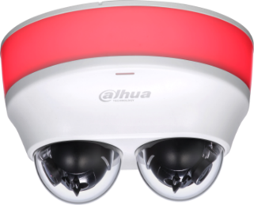
Overview
Single-Lens Camera
Duel-Lens Camera

Slide 8
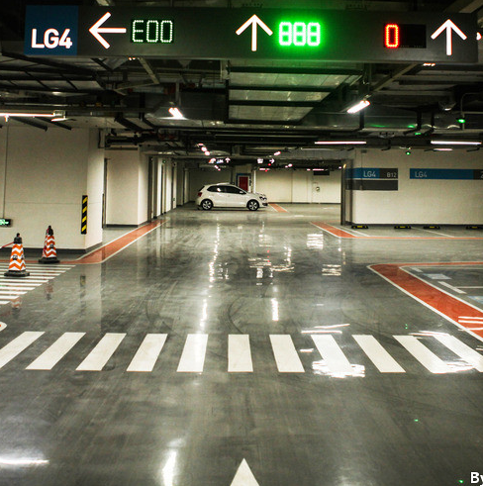

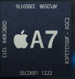




Feature
Great Image
Strong Heart
Intelligence
Easy installation
Indication
Multiple interface

Slide 9
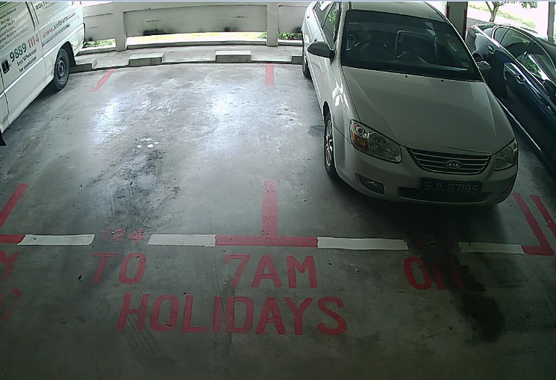
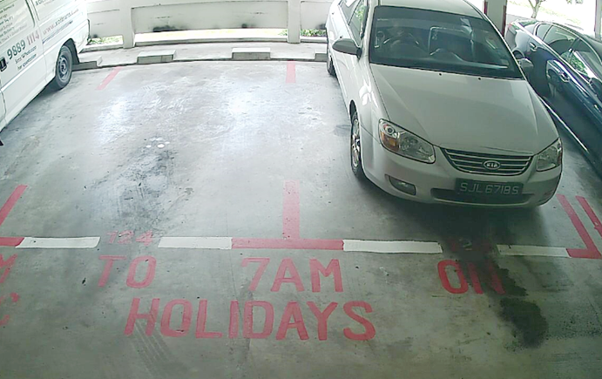
Feature| Great Image
— Super wide dynamic range
WDR OFF
WDR ON

Slide 10
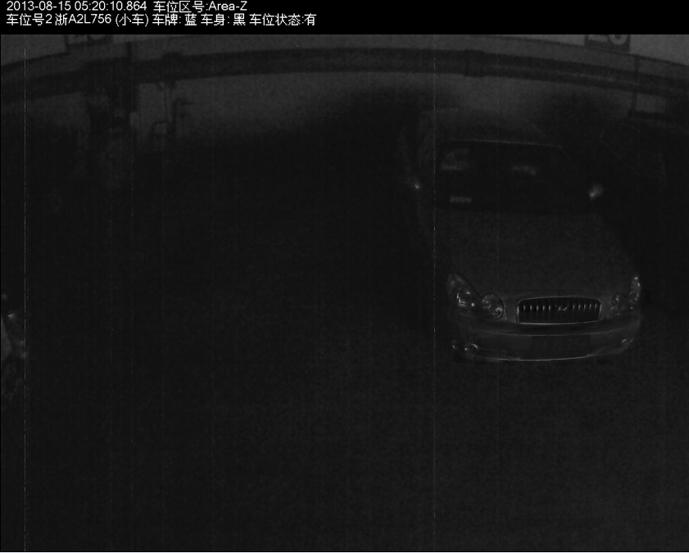
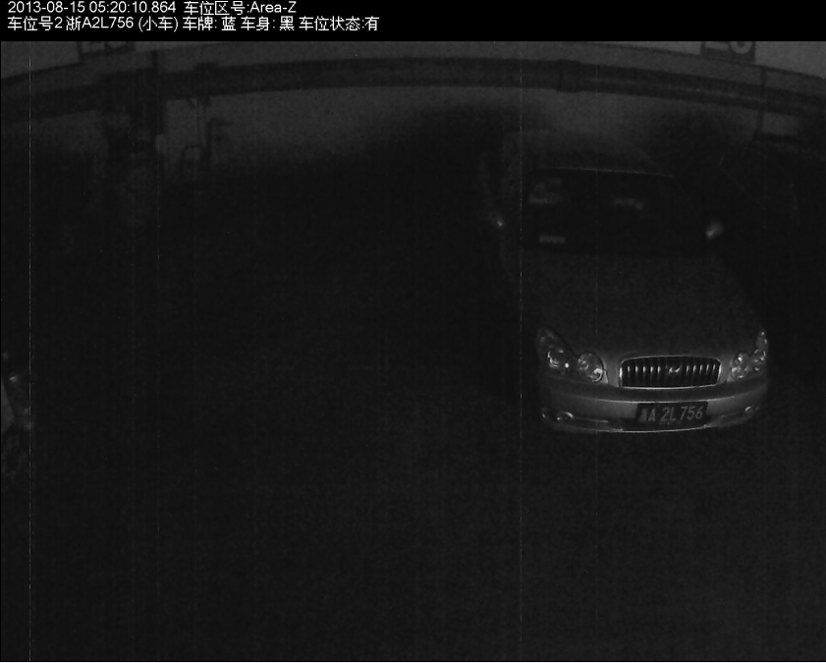
Feature| Great Image
— See clearly in darkness
Ordinary
Starlight

Slide 11
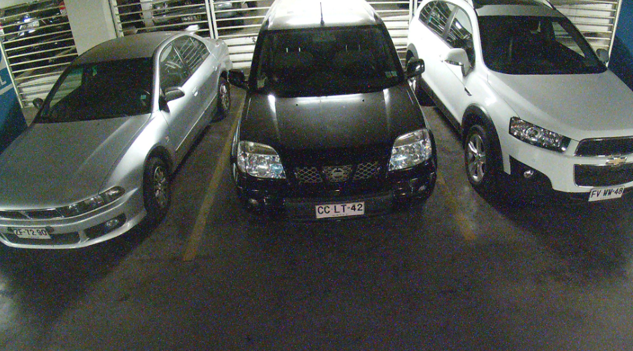
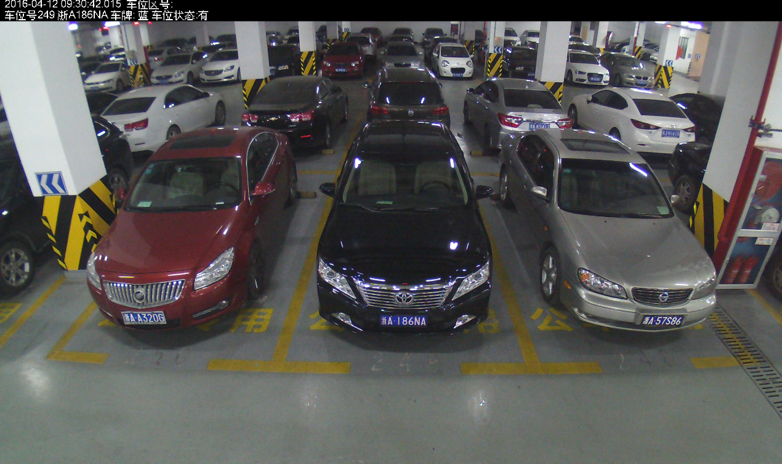

Feature| Great Image
— Correct the edge view
Normal
Correct

Slide 12
Feature| Strong Heart
— Monitor the live video
15FPS
30FPS
1st Generation
2st Generation

Slide 13
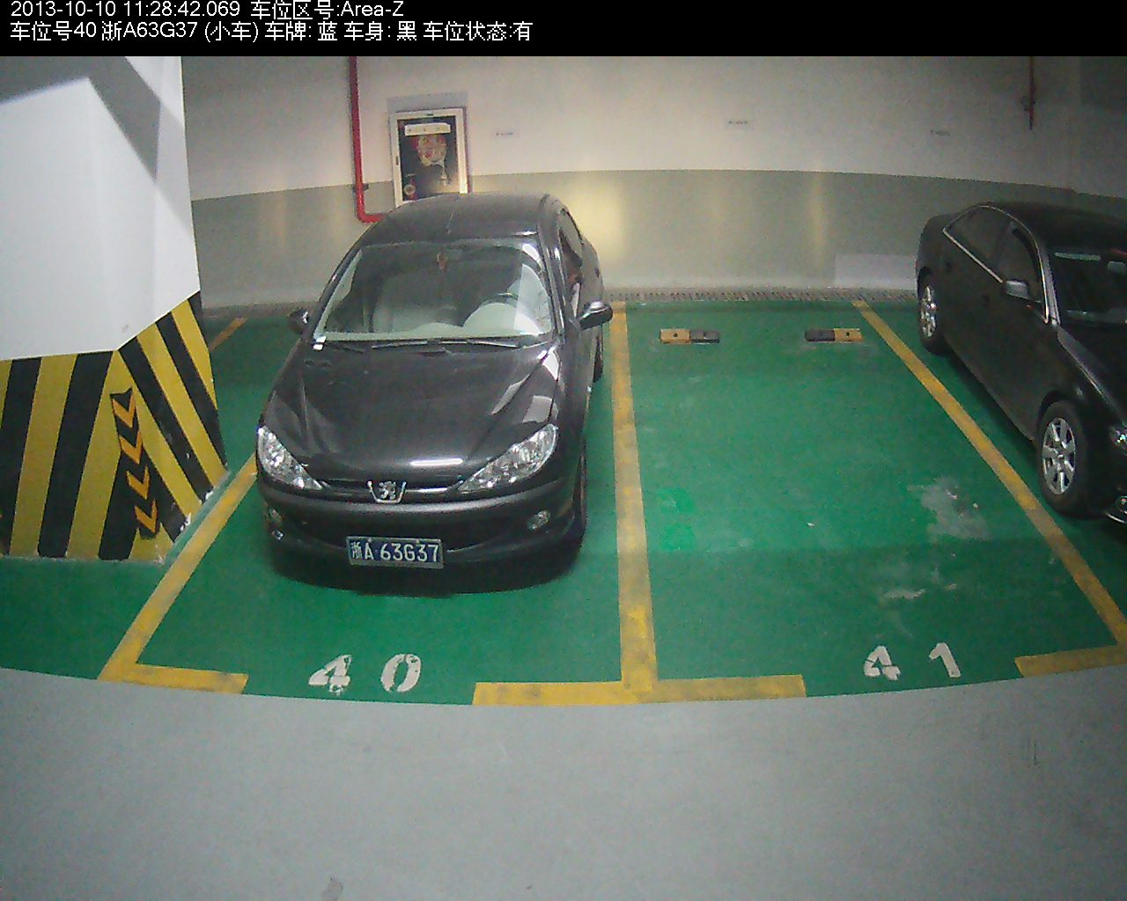
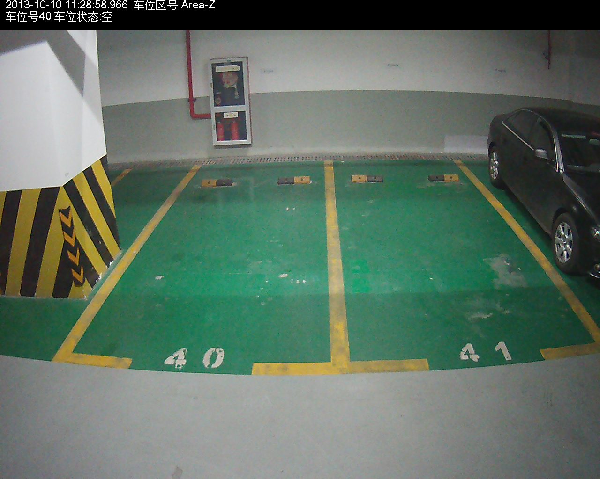
Feature| Strong Heart
— Snapshot if lot space changes
Find it occupied
Find it available

Slide 14
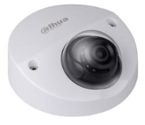

Feature| Intelligence
— OCR on board
be
plus
Normal Camera
PC Algorithm
Smart Camera

Slide 15

Feature| Intelligence
— Multiple algorithm inside
Plate Number
Vehicle shape
Vehicle Sign, light, etc…

Slide 16
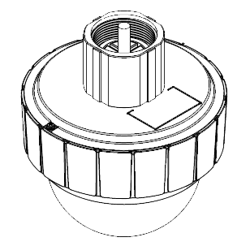
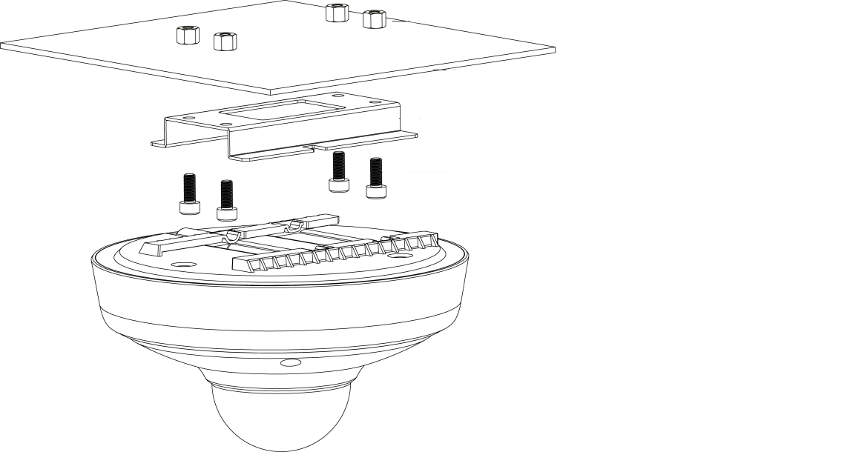
Feature| Easy Installation
— One-step to install
Bracket+Screw
Double-screw bolt

Slide 17
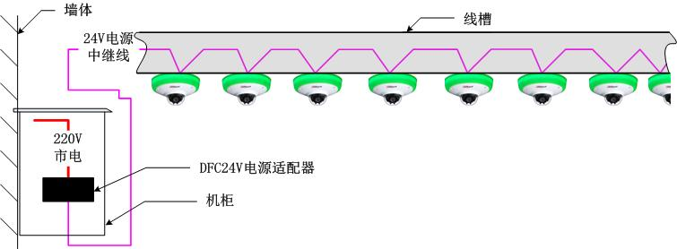

Feature| Easy Installation
— Wide range voltage
Wall
Cable Slot
24V Power Junction Line
220V Power Supply
DFC24V Power Adapter
Cabinet
DC 8~26V
Cascade more parking detectors in a certain power

Slide 18
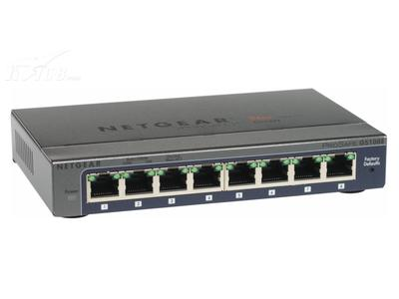

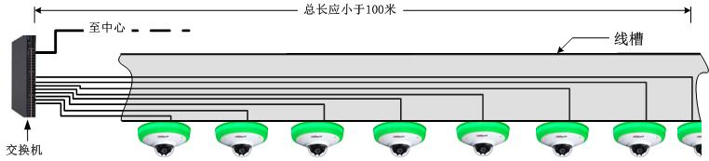
Feature| Easy Installation
— Connection one by one
Two Ethernet ports
Cascade with up to 10 devices when video and images need
Reduce the cost of cabling, materials and human
Shorter than 100m
Center
Cable Slot
Switch

Slide 19



Feature| Easy Installation
— Don’t worry lose camera
No Bypass
Bypass
Direct physical connection between the two camera

Slide 20

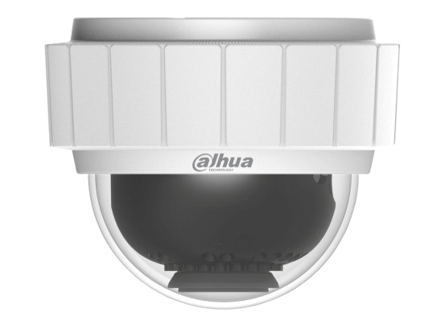
Feature| Indication
— Obvious LED to guidance
LED: 8 different color(including colourless)+ Flick for each
Integrate camera with LED together
Low consumption: <7W

Slide 21
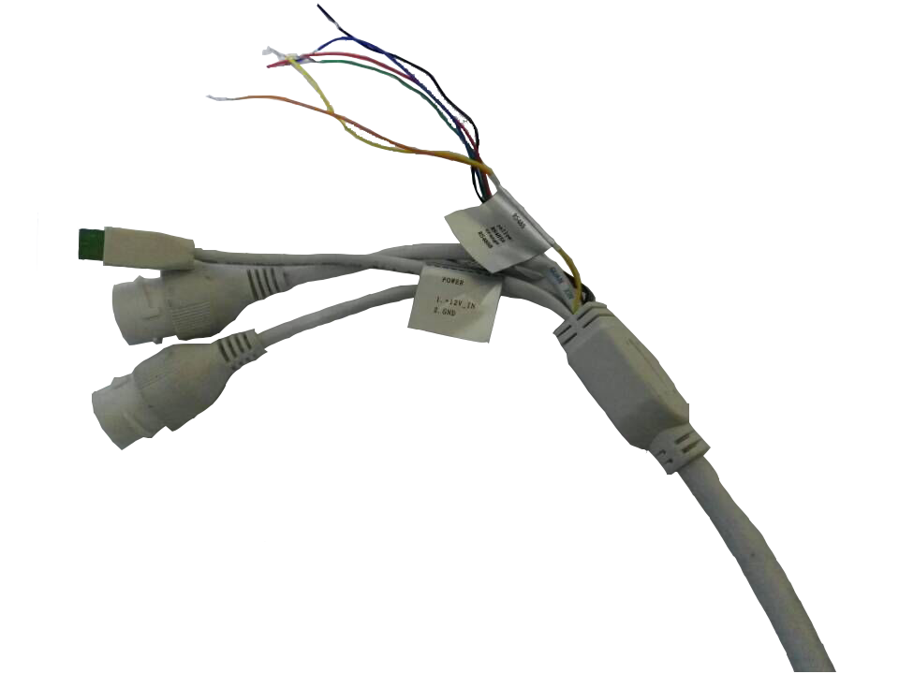
Feature| Interface
— Integrate with special function
RS485: Integrate with the separate indicator led.
IO in/out: Integrate with the alarm sensor

Slide 22
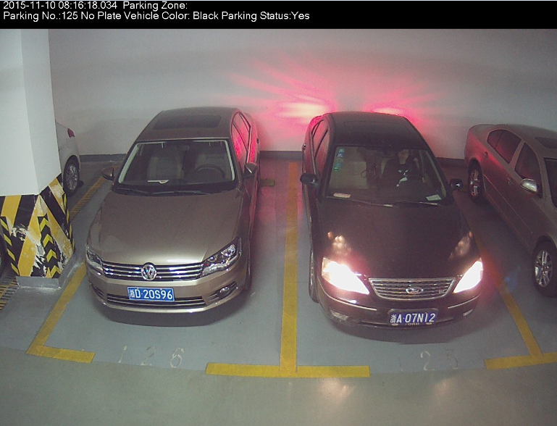
Single-Lens Camera| Product Overview
ITC114-PH1B-F3/6 (2 lots)
  1.3MP 1/3”inch CMOS, 0.01lux min illumination
  Support dual stream output of JPEG and H.264, 1~30fps adjustable
  Image resolution: 1280×960, 3.6/6mm lens
  Embed indication light, Support parking space detection and light control
  2 10/100M Ethernet port, support data switch
  Power supply: DC 8V～26V
  Work temperature: -30~60℃
  2 parking space coverage
  Support SDK, easy integration with parking system

Slide 23
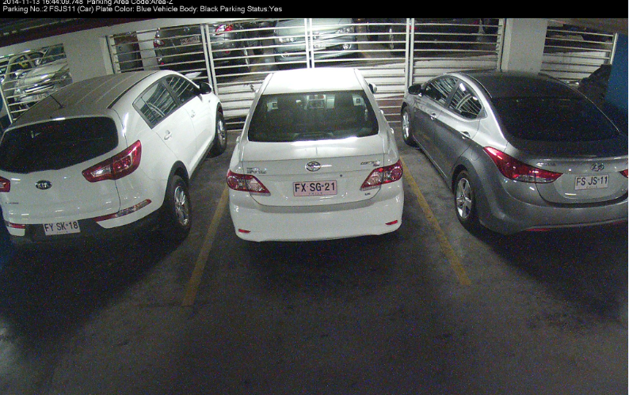
Single-Lens Camera| Product Overview
ITC314-PH1B-F2/3(3 lots)
  3MP 1/3”inch CMOS, 0.01lux min illumination
  Support dual stream output of JPEG and H.264, 1~20fps adjustable
  Image resolution: 2304×1296, 3.6/2.8mm lens
  Embed indication light, Support parking space detection and light control
  2 10/100M Ethernet port, support data switch
  Power supply: DC 8V～26V
  Work temperature: -30~60℃
  3 parking space coverage
  Support SDK, easy integration with parking system

Slide 24
Overview
Single-Lens Camera
Duel-Lens Camera

Slide 25
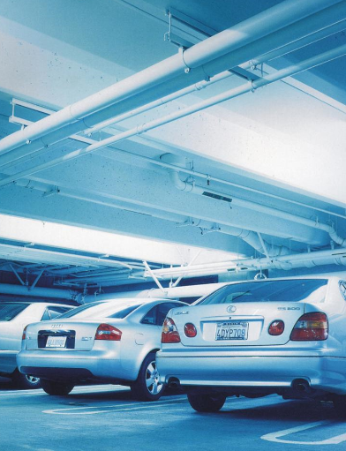

Feature
Duel-lens design
Strong Heart

Slide 26
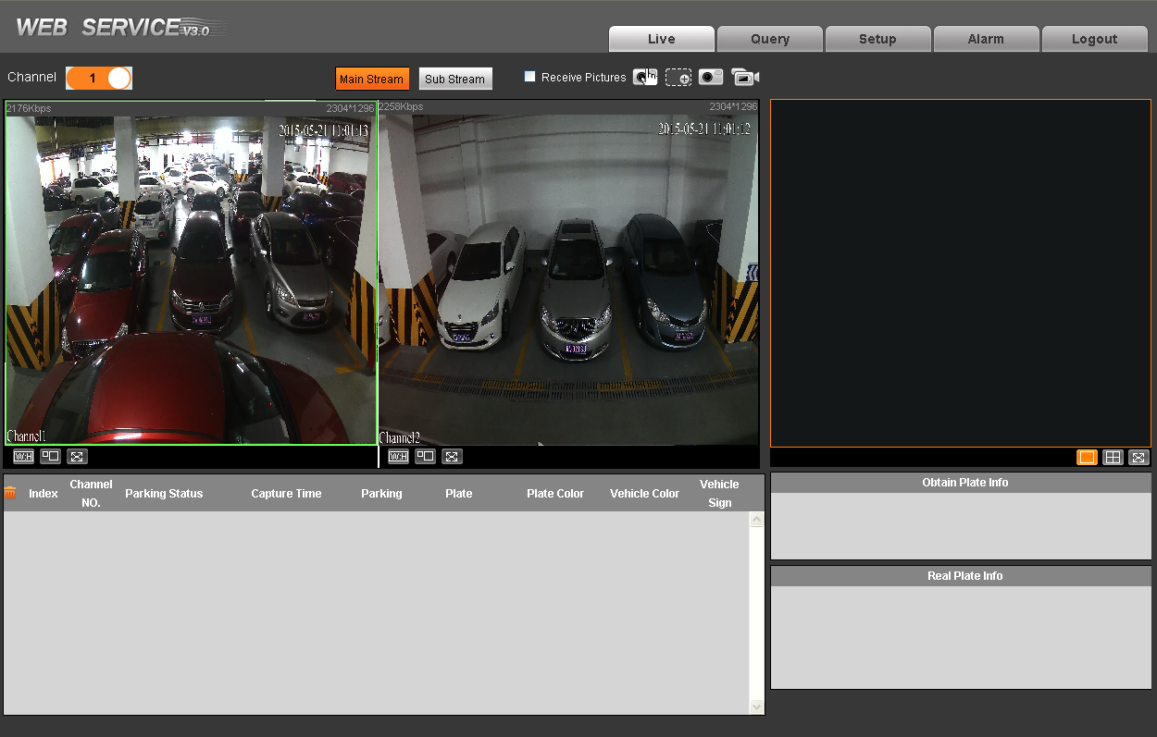
Feature| Duel-lens design
— Monitor vehicle in both sides
Encoding 2 channel 3MP video stream, 10 fps for each one

Slide 27
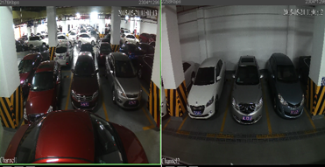
Duel-lens Camera| Product Overview
ITC314-PH1A-TF2(6 lots)
  3MP 1/3”inch CMOS, 0.01lux min illumination
  Support dual stream output of JPEG and H.264, 1~10fps adjustable
  Image resolution: 2304×1296, 2.8mm lens
  Embed indication light, Support parking space detection and light control
  2 10/100M Ethernet port, support data switch
  Power supply: DC 8V～26V
  Work temperature: -30~60℃
  6 parking space coverage
  Support SDK, easy integration with parking system

Slide 28

Material info
 | ITC114-PH1B-F3(3.6mm)
 | ITC114-PH1B-F6(6mm)
 | ITC314-PH1B-F2(2.8mm)
 | ITC314-PH1B-F3(3.6mm)
 | ITC314-PH1A-TF2(2.8mm)

Slide 29
Thank You!

