Slide 1

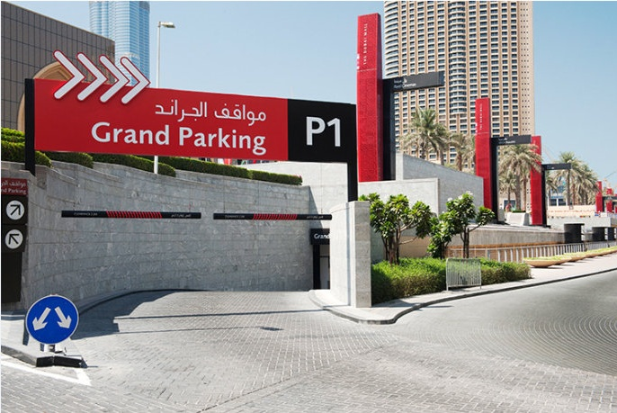
Dahua
Parking Guidance System Solution

Slide 2
Requirement

Slide 3
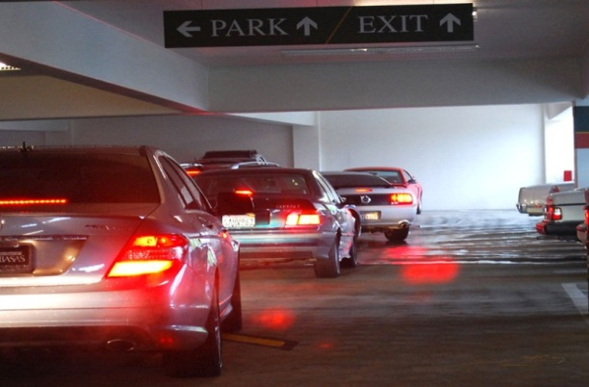
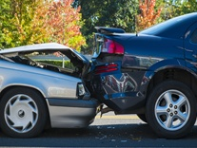
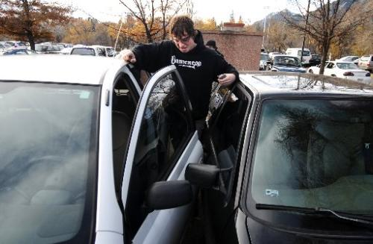
Requirements
Existing Problem
Hard to manage the
parking lot
Hard to find an
available parking space
Hard to find
evidence for accidents

Slide 4
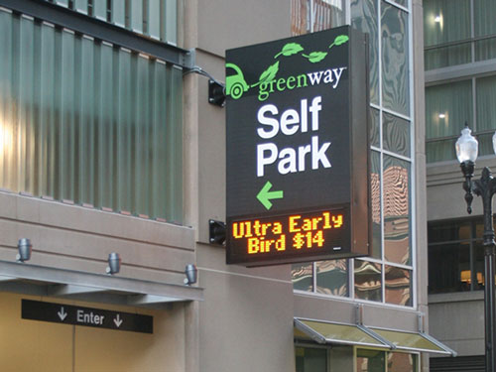
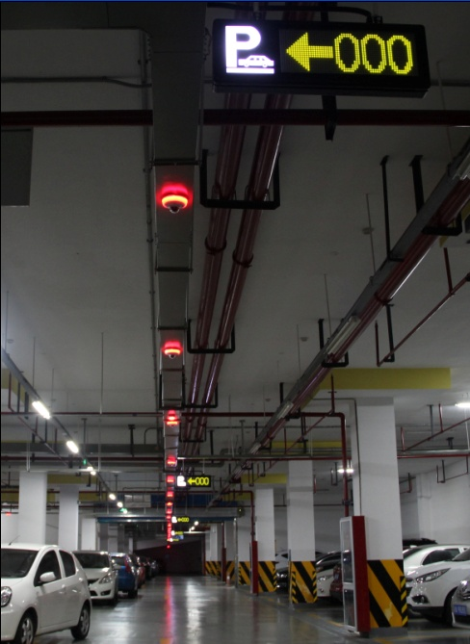
Requirements
An Excellent System
A stable
running system
Efficient for finding space
Visualized parking management
Reasonable construction cost
High definition surveillance
Find evidence for disputes

Slide 5
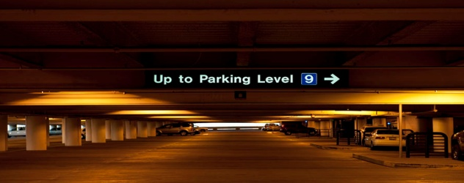

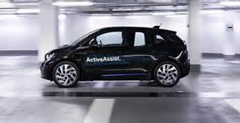

Requirements
System Overview
Subject
深化业务实战应用
智能化实战平台
Front-End
Video Surveillance
LRP
Space Detection
Parking Guidance
Space Protection
Accurate Charge
Manage Center
Authentication
Guidance
Analytics

Slide 6
System Design

Slide 7
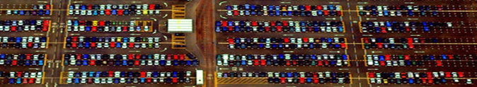
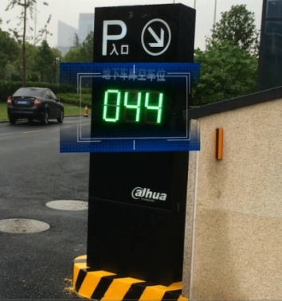
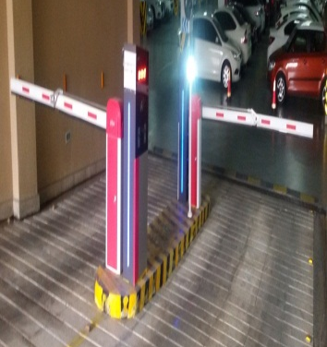
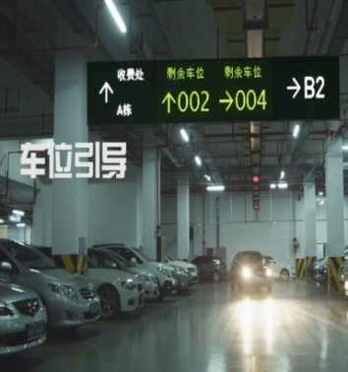
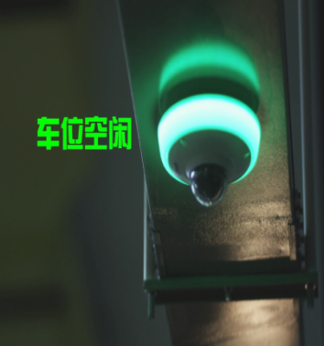
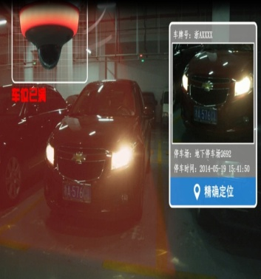
System Design
Parking Guidance Process
Entry
Guidance
Available
Full
Guidance

Slide 8






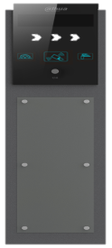




System Design
System Topology
Access Management
DSS4004-H
EVS7024S-R
Management Center
Parking Area
Guidance
E
I/O
Barrier
Controller
LPR Camera
Detector
Guidance Screen
Guidance Screen
Network cable
Entrance & Exit
Parking Area

Slide 9
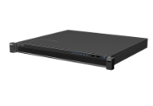


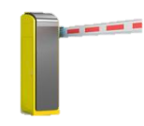


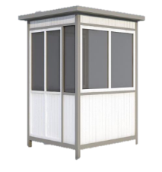


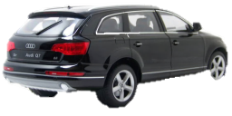
System Design
Entrance & Exit
One platform to manage multiple entrances and exits
Intelligent parking system
Management center
Induction Loop
Barrier
Camera
Induction Loop
Induction Loop
Camera
Entrance1
Barrier
Barrier opens and camera snapshots when the first induction loop is triggered
Induction Loop
Exit1

Slide 10
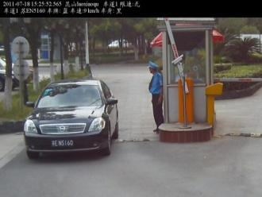



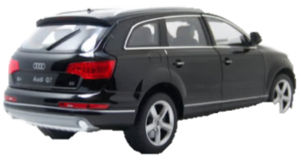
System Design
Entry Process
Data is uploaded
to the platform
Plate number recognition A0011X，
Time：16:05
DSS4004-PSM
Entrance
Induction Loop
Induction Loop
Notes:
Car reaches the entrance—Trigger the loop—The entrance camera captures an image and recognizes plate number---open the barrier and uploaded the date to the platpform software to track the car

Slide 11
System Design
Exit Process
Car reaches the exit
trigger the loop
The entrance camera captures an image and recognizes plate number
Car leaves
The exit camera triggers barrier to open
Camera capture a image and do LRP
Data is uploaded to the platform and compare the plate number

Slide 12
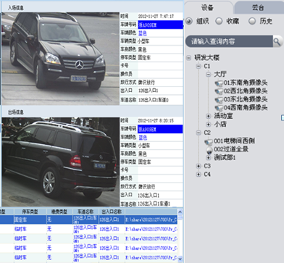

System Design
Exit Process
Plate number check and comparison
Plate number recognition A0011X，
Time：19:15
DSS4004-PSM
Exit
Induction Loop
Induction Loop
Notes:
Car reaches the entrance—Trigger the loop—The entrance camera captures an image and recognizes plate number---upload the date to the platpform software to compare the plate number---camera trigger to open the barrier

Slide 13
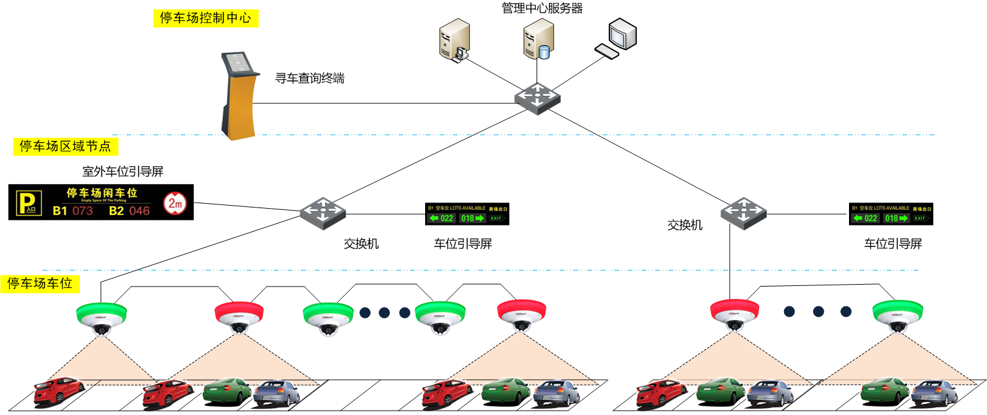
System Design
Parking Guidance
DSS4004-PSM
All the information such as space status, vehicle type and images are uploaded to the platform
Each detection camera covers 2 or 3 spaces. More than 20 detection cameras can be cascaded.
Position terminal
Manage center
Parking Area
Outdoor screen
Switch
Parking detection camera deployed in cascade mode
Switch
Guidance screen
Guidance screen

Slide 14
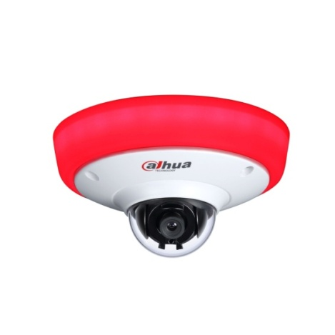
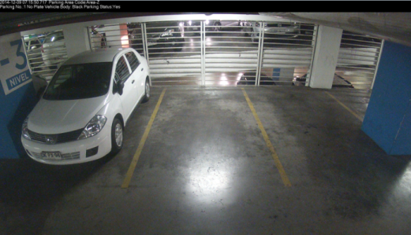
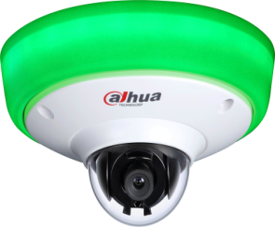
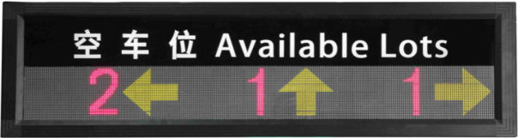
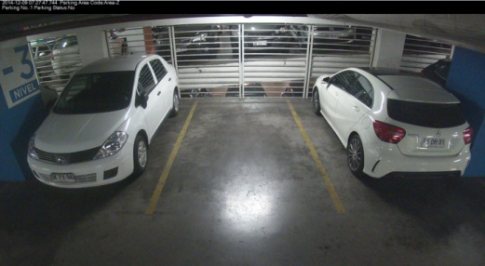
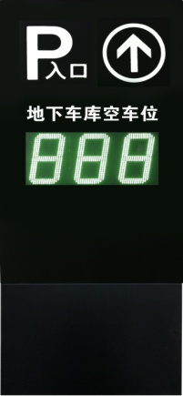
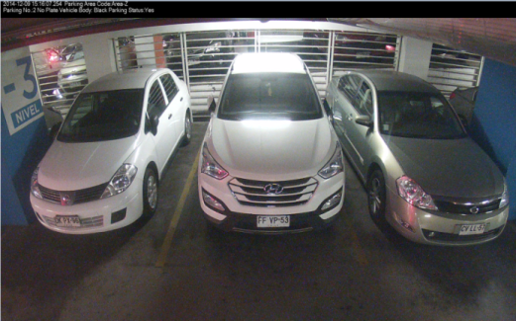
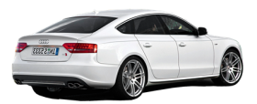
System Design
Space Detection
Detection Camera is able to detect the parking status by vehicle type even without plate number
8
10
9
50
48
49

Slide 15
Solution Design
System Management
Device
LRP Camera
Detection Camera
Barrier
Function
24-Hour real-time Surveillance
Device management
Alarm Linkage
Visualized space status
Record storage
Image storage
Electronic map
History Search
Reports
Vehicle Flow Reports
Parking history Reports
Other Reports

Slide 16
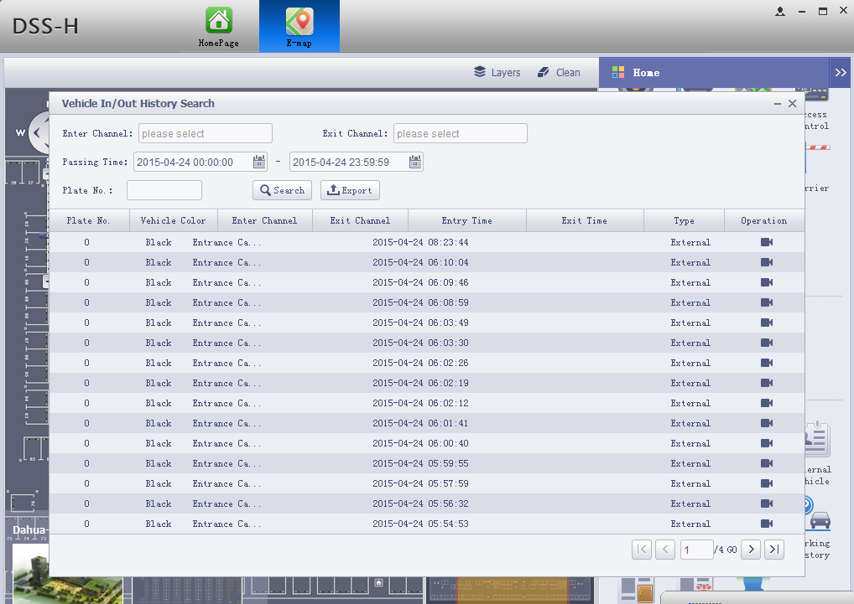
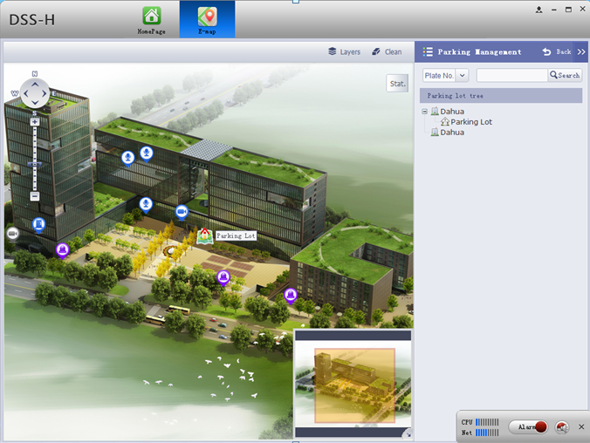
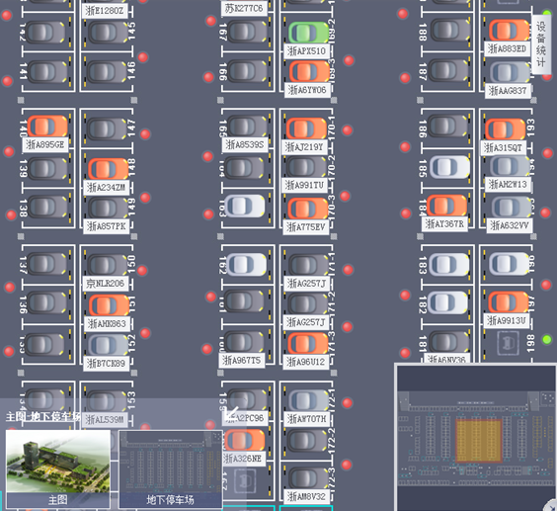
Solution Design
Management Client
Visualized Parking Lot
Entrance History

Slide 17
Highlight

Slide 18
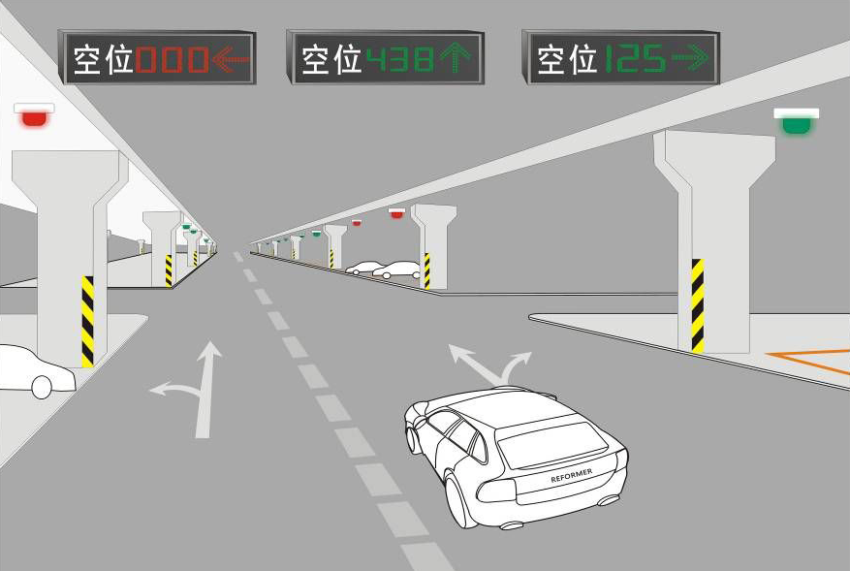
Highlight
Fast Guidance
Show Available Parking Space
Guidance screen will show the available parking space number to drivers and guide then to the right direction
Show Accurate Position
Drivers can search available spaces according to the light indicator and guidance screen indication.

Slide 19
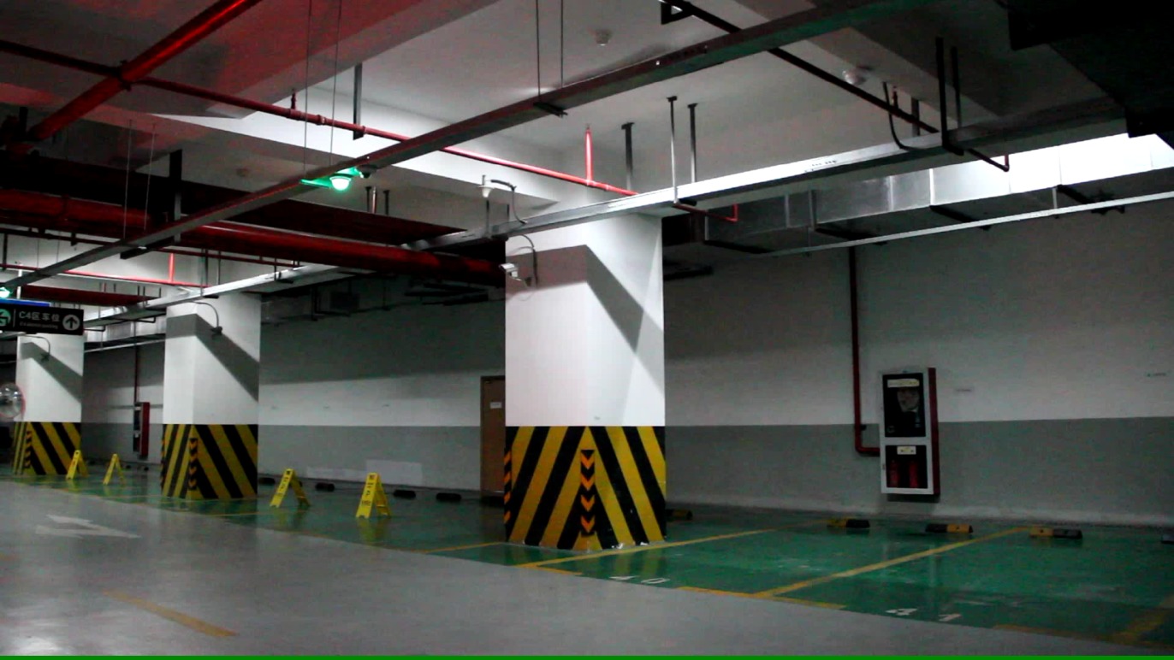
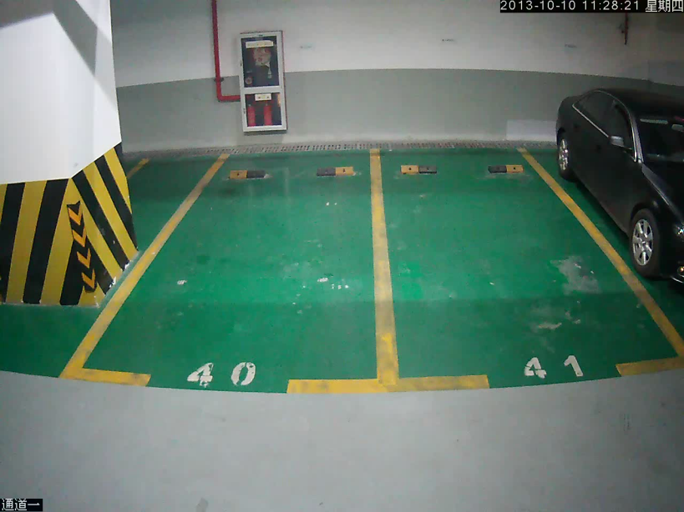
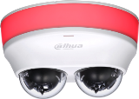
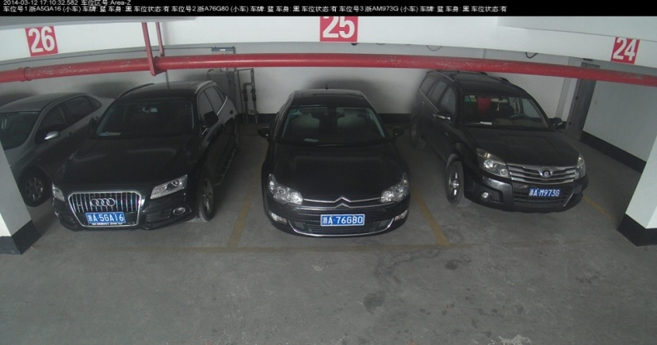
Highlight
All-Round Monitoring
Snapshot
Record
Cover 3 Parking Spaces

Slide 20
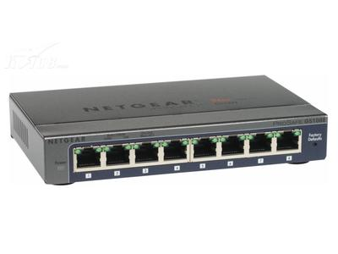

Highlight
Simplify Deployment
Innovative way
Traditional way
Simplify Deployment & Cost Down
Reduce UTP cable deployment and cost （83%）
Reduce the quantities of switches
Reduce the cost of cable bridge（63% ）
Notes:
按一排10个摄像机，30个车位来计算
双网口网络级联模式：

Slide 21
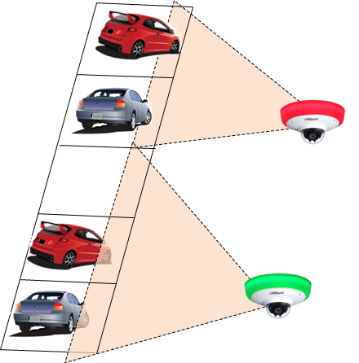

Highlight
Cost Down
Traditional way
Two cameras inside make cost down
Traditional way only cover 2~3 parking spaces
Innovative way can cover 6 parking spaces
Reduce the cost of camera（about 50% ）
Innovative way

Slide 22
Product

Slide 23
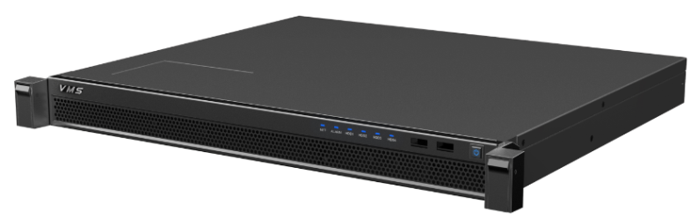
Product
Parking System Platform
Processor | Baytrail J1900platform, 4core 2.0G CPU
Operating System | Embedded Linux
Memory | 8GB,expansible,ECC validation
Ethernet Interface | 4 * 100/1000Mbs
USB Interface | 2* front USB3.0 2* back USB2.0
VGA Interface | 1
Disk | 4* 2.5’’, full built-in，or 2* 3.5’’
Disk Mode | Single, RAID0, RAID1, RAID5
Power Supply | 100V ~ 240V，47 ~ 63Hz
Consumption | 10W~200W (Disk included)
Temperature | 0℃~50℃
Installation | Standard 19’’ rack-mounted
Second Development | Support SDK
DSS4004-PSM

Slide 24
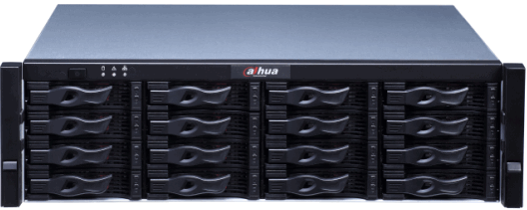
Product
Central Storage
Controller | Single
Processor | 64 bit high-performance multi-core processor
Memory | 8G standard, up to 16G
Operating System | Embedded Linux
SAS Interface | 2
1000 Mbps Ethernet Port | 1 Mgmt, 4 Data
HDD Compatibility | 1T,2T,3T,4T, support mixed SAS and SATA HDDs, support SSD, 2.5 inch HDD
Power Redundancy | Dual power supply
Cluster Mode | Support N+M cluster
Video Stream Mode | Support RTP/RTCP/RTSP/UDP/HTTP/NTP/SNMP/iSCSI/SMB/NFS/FTP protocols
Streaming Media Protocol | Support access protocol such as ONVIF,PSIA
Performance | Up to 512ch(1024Mbps) front-end access, storage, transmit, 64ch(128Mbps) network playback
EVS7024S-R

Slide 25
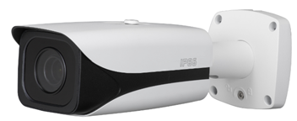
Product
LPR Camera
Resolution | 2 Mega，1920(H)*1080(V)
Image Sensor | 1/1.9 inch 2 Megara CMOS
HD Video Format | H.264 standard, main profile 5.0
HD Image Resolution | 1920(H)*1080(V)
HD Video Resolution | 1920(H)*1080(V)
HD Video Frame Rate | 50fps
ITC237-PW1A-IRZ
2 LED Light build-in, brightness adjustable
Support plate Recognition (license plate and color)
Support two way vehicle snapshot (loop and video)

Slide 26
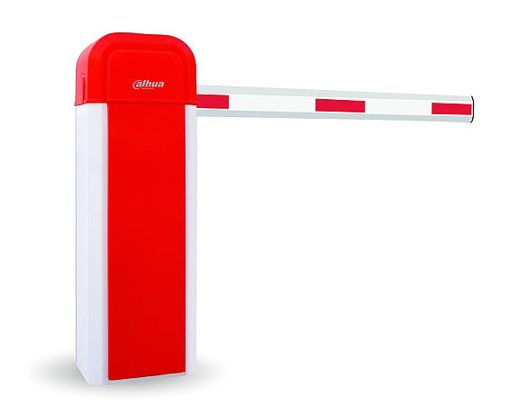
Product
Barrier
Protocol | RS485
Input voltage | AC220±10%，50Hz
Service life | >3.5 million times
Temperature | -25℃ to 50℃
Speed | Series D: 1.6-2s, Series C:3s Series B:6s
Type | straight/crank arm/lighting rod
Length | 3/ 4/ 6 m
Protection Level | IP44
DH-IPMECD Series
Perform open and close according to the signal from entrance camera and induction loop or from platform

Slide 27

Product
Detection Camera
Sensor | 1/3 inch CMOS
Monitor scene | 2/3 parking space
Image resolution | 2048×1536, 2304×1296
Video resolution | 2048×1536, 2304×1296
Day/Night: | Electronic color to black/white
lens | 2.8/3.6mm lens optional
Input Voltage | 8V – 26V
Temperature | -30℃ -- 60℃
Ethernet Interface | 2, 10/100M optional
ITC314-PH1A-F2
ITC314-PH1A-F3
Embedded with OCR, LPR, detect the parking space, light indication
Support SDK to integrate with parking management platform

Slide 28
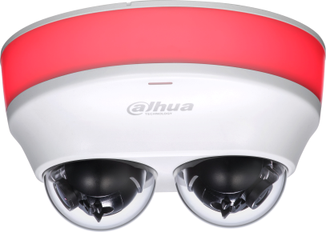
Product
Detection Camera
Sensor | 1/3 inch CMOS
Monitor scene | 4/6 parking space
Image resolution | 2048×1536, 2304×1296
Video resolution | 2048×1536, 2304×1296
Day/Night: | Electronic color to black/white
lens | 2.8/3.6mm lens optional
Input Voltage | 8V – 26V
Temperature | -30℃ -- 60℃
Ethernet Interface | 2, 10/100M optional
ITC314-PH1A-TF2
ITC314-PH1A-TF3
Embedded with OCR, LPR, detect the parking space, light indication
Support SDK to integrate with parking management platform

Slide 29
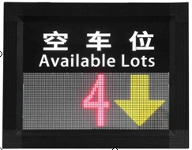
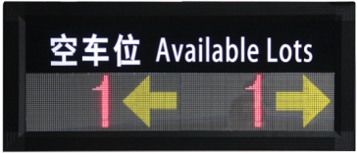

Product
Indoor LED Screen
Size | 480*380*102 mm 860*380*102 mm 1240*380*102 mm
Input voltage | AC220V
Distance between pixel | 5 mm
Protocol | RS485
Temperature | -10℃~70℃
DH-IPMPGI-110AA
DH-IPMPGI-120AA
DH-IPMPGI-130AA

Slide 30
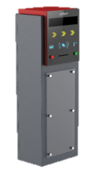
Product
Entrance Controller
Size | 400*296*1504（mm）
Display Panel Size | 305mm×76mm
Input voltage | AC220V
Interface | RS485 * 3, RS232 * 3, 1 loop input, RJ45 100M * 1
Card Writer | Built-in
Temperature | -30℃ to 70℃
Humidity | 20～90％RH
DH-IPMECK-200EB
Record entry/exit time
Trigger the barrier to open
DH-IPMECK-200OB

Slide 31
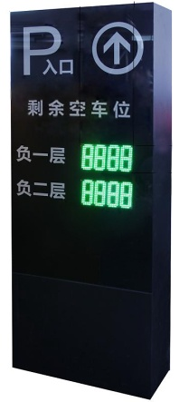

Product
Outdoor LED Screen
Number Display Range | 0-999 0-9999 0-99999
Input voltage | AC220V
Display Color | Green
Protocol | RS485
Temperature | -10℃~70℃
DH-IPMPGI-140AA
DH-IPMPGI-150AA
DH-IPMPGI-160AA

Slide 32
DAHUA
Make your life safe
Thank you！

